Slide 1

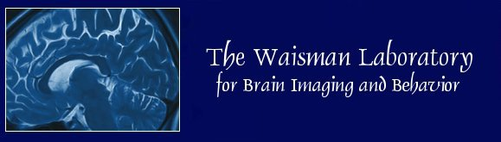
Topological Data Analysis on the
Space of Brain Network Models
Moo K. Chung
University of Wisconsin-Madison
www.cs.wisc.edu/~mchung
ENAR 116 Current Trend in Topological Data Analysis March 15 Wed 10:30am
Notes:
My talk is 9:30am

Slide 2
Collaborators & coauthors
Yuan Wang, Nagesh Adlur, Paul J. Rathouz,
Seth Pollack, Andrew Alexander, Richard Davidson
University of Wisconsin-Madison
Hyekyung Lee
Seoul National University
Jamie Hanson
University of Pittsburgh
Seth Pollack, Victoria Vilalta-Gil, David H. Zald
Vanderbilt University
Benjamin B. Lahey
University of Chicago

Slide 3
Postdoctoral Position
2017-2019
Please send your CV to mkchung@wisc.edu.
Project detail:
www.stat.wisc.edu/~mchung/twins

Slide 4
Paired brain images

Slide 5
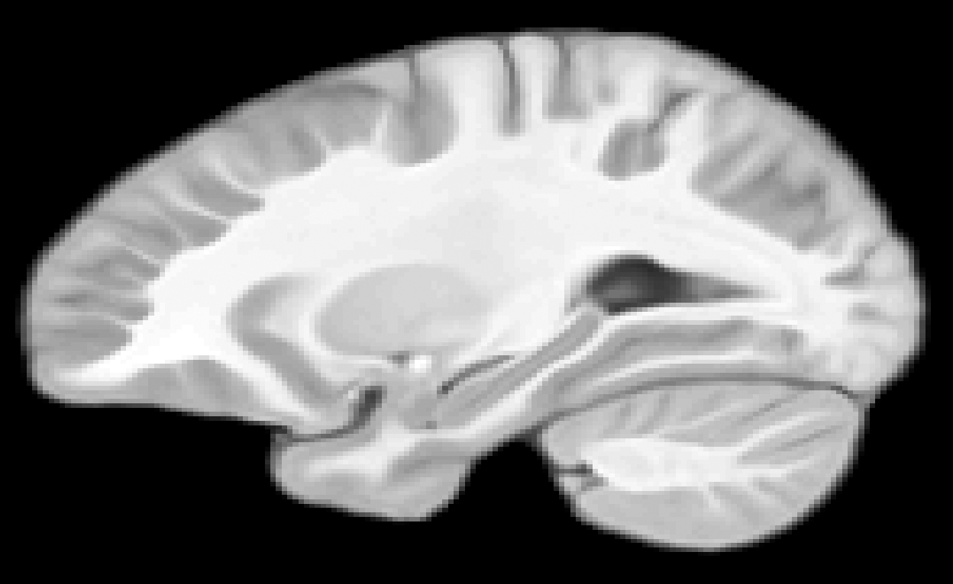
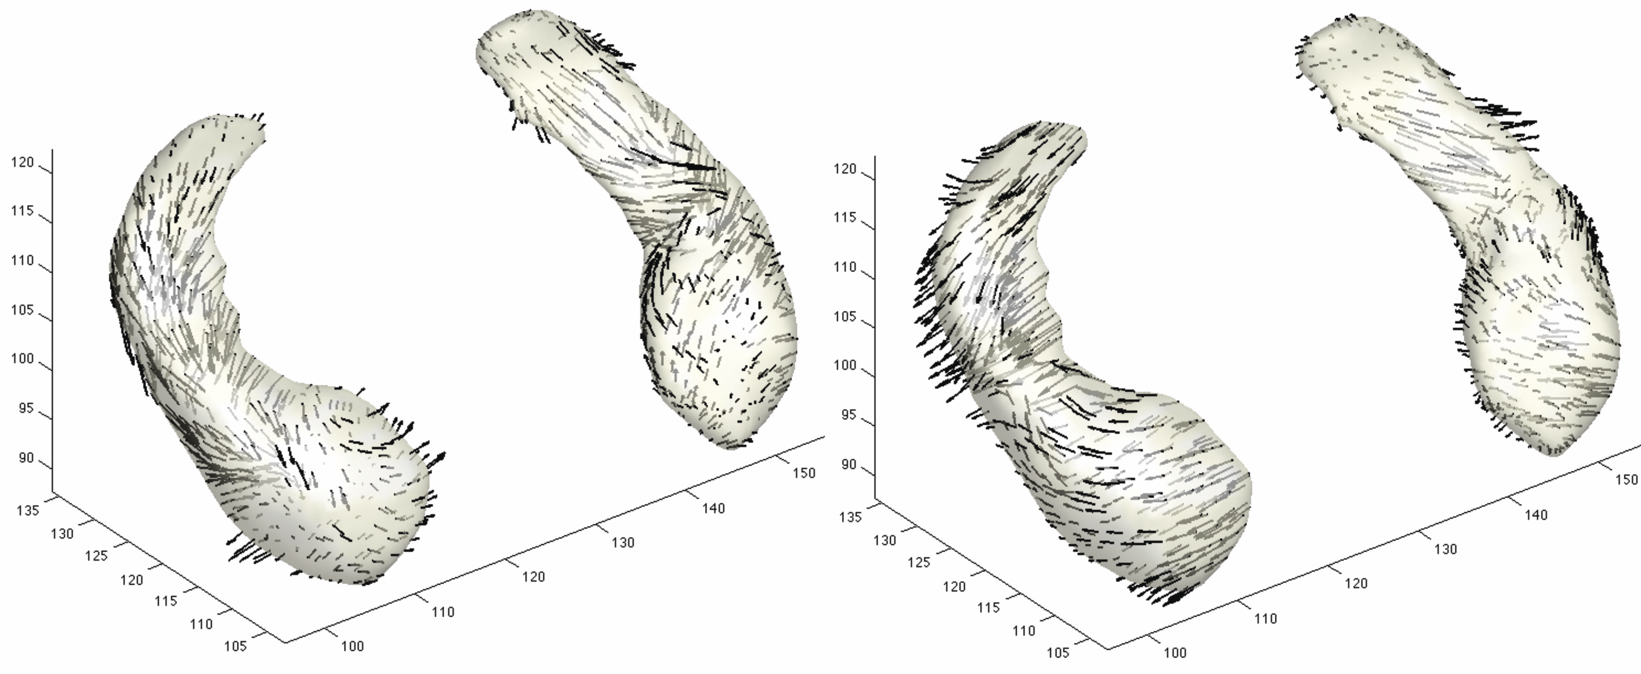
Paired longitudinal image study
Two MRI scans per subject
Displacement vector field between paired images
Notes:
82 pairs 14+3.9 years

Slide 6
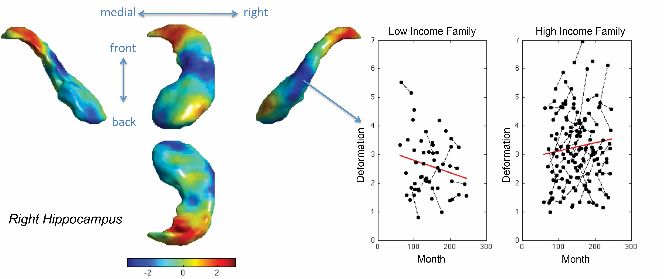
Paired longitudinal image study
Hippocampus growth depends on parent’s income level
Chung et al. 2016 in Handbook of NeuroImaging Data Analysis
Notes:
82 pairs 14+3.9 years

Slide 7
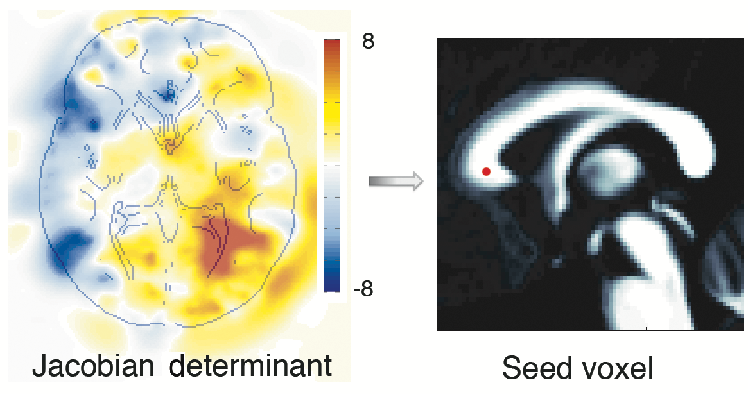
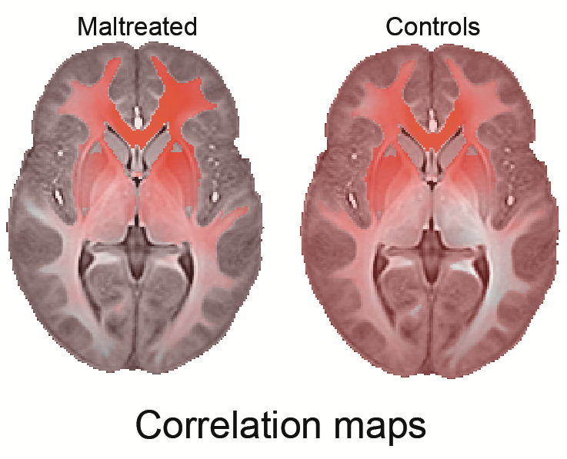
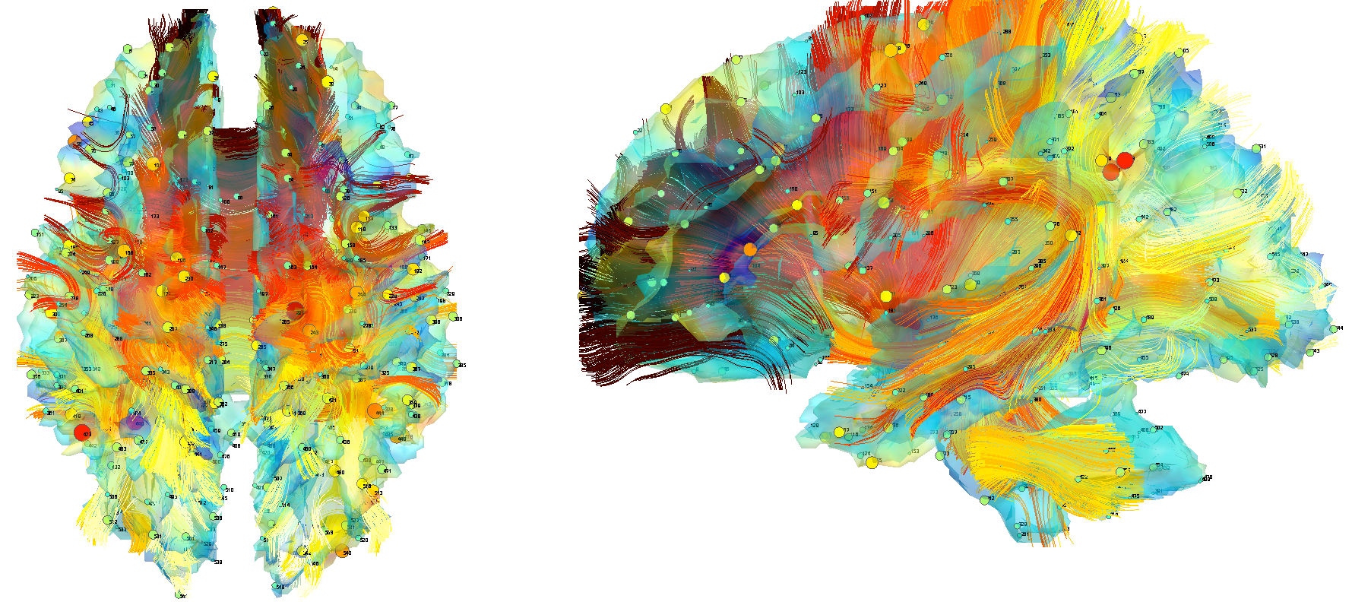
Paired Multimodal imaging study (MRI + DTI)
MRI
DTI
Fractional
anisotropy (FA)
Notes:
23 maltreated 31 controls

Slide 8
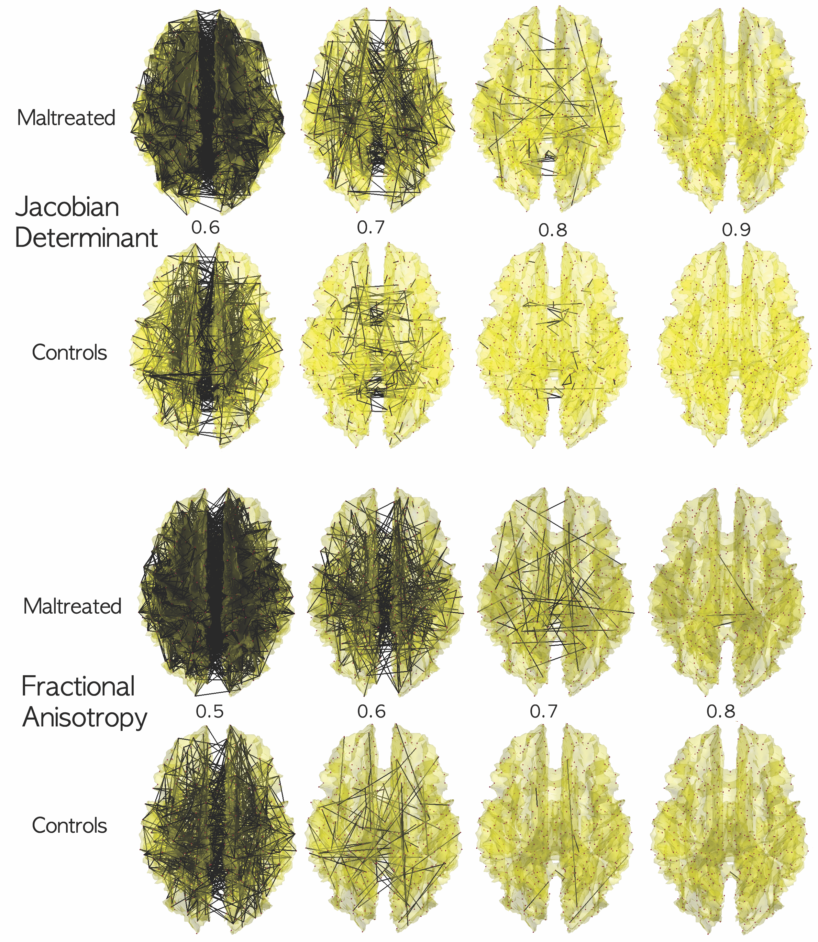
Paired Multimodal imaging study (MRI + DTI)
Networks
obtained after
thresholding
correlations
Chung et al. 2015.
IEEE Transactions on Medical Imaging 34:1928-1939
Notes:
23 maltreated 31 controls

Slide 9
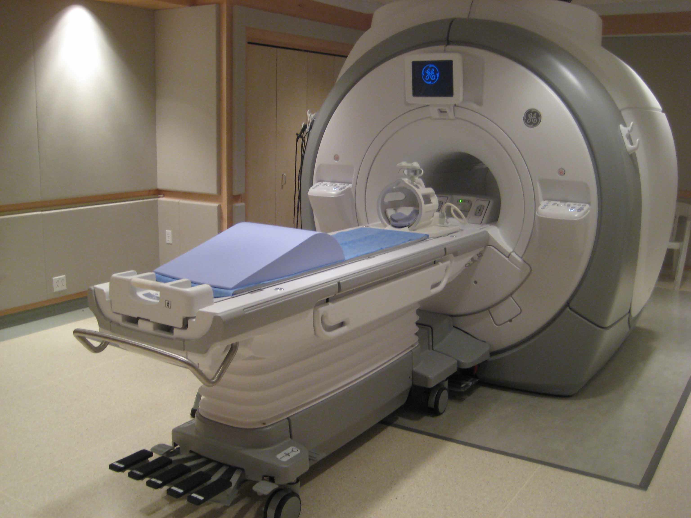
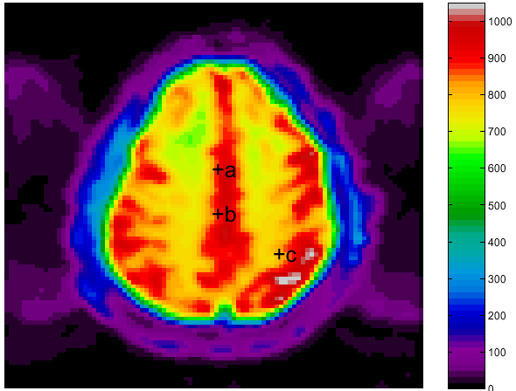
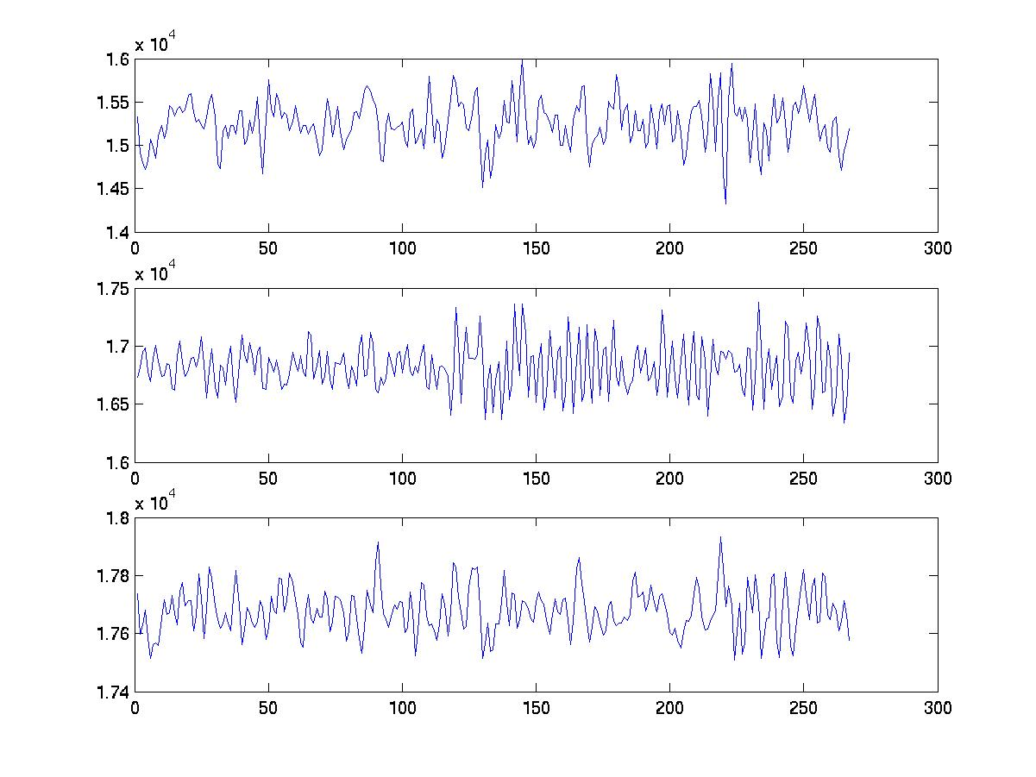
Twin functional-MRI study
11 monozygotic (MZ) twins
14 dizygotic (DZ) twins
9 same-sex DZ pairs (5 male, 4 female) 5 different-sex DZ pairs
b
Notes:
Total sample size n=22 + 18 = 40

Slide 10
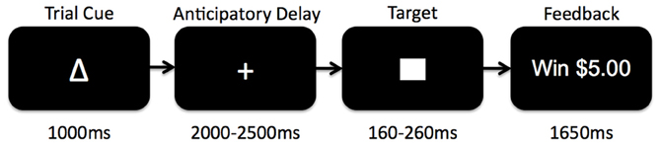
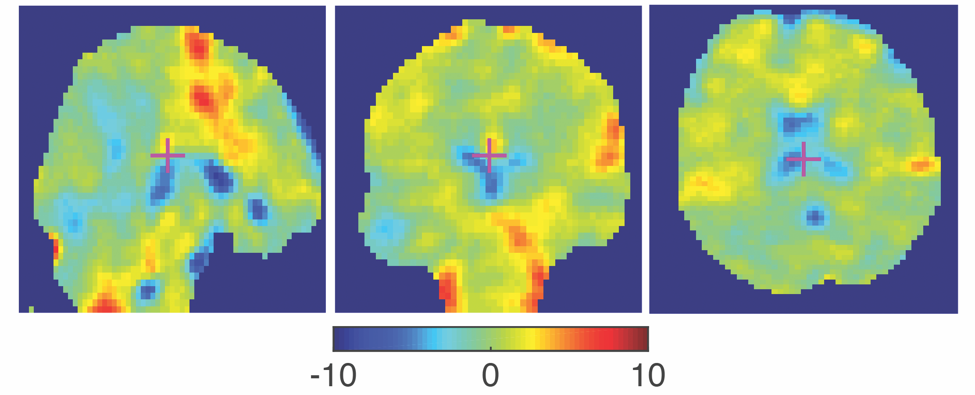
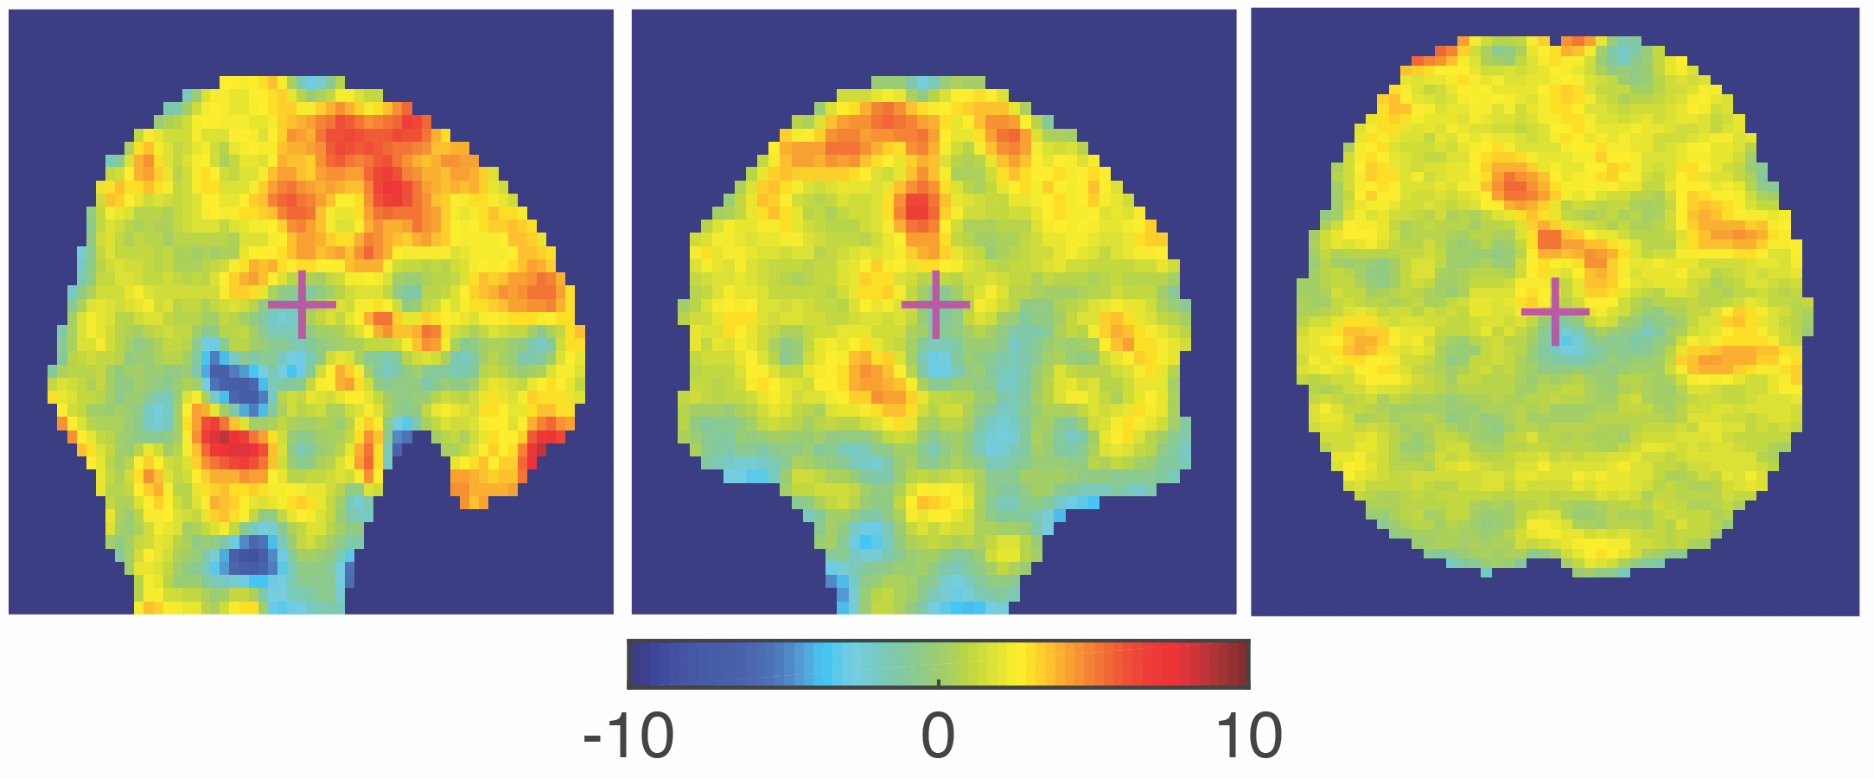
Paired contrast images
Monetary incentive delay task
$0, $1, $5
General Linear Model
3 runs of 40 trials
delay for $0 trials
delay for $1 trials
delay for $5 trials
Contrast map
Notes:
MZ-twin example
9 conditions (each condition also includes a time and a dispersion derivative)
delay for $0 trials
delay for $1 trials
delay for $5 trials
reward $0
reward $1
reward $5
miss $0
miss $1
miss $5

Slide 11
Sparse hyper-networks on paired images

Slide 12
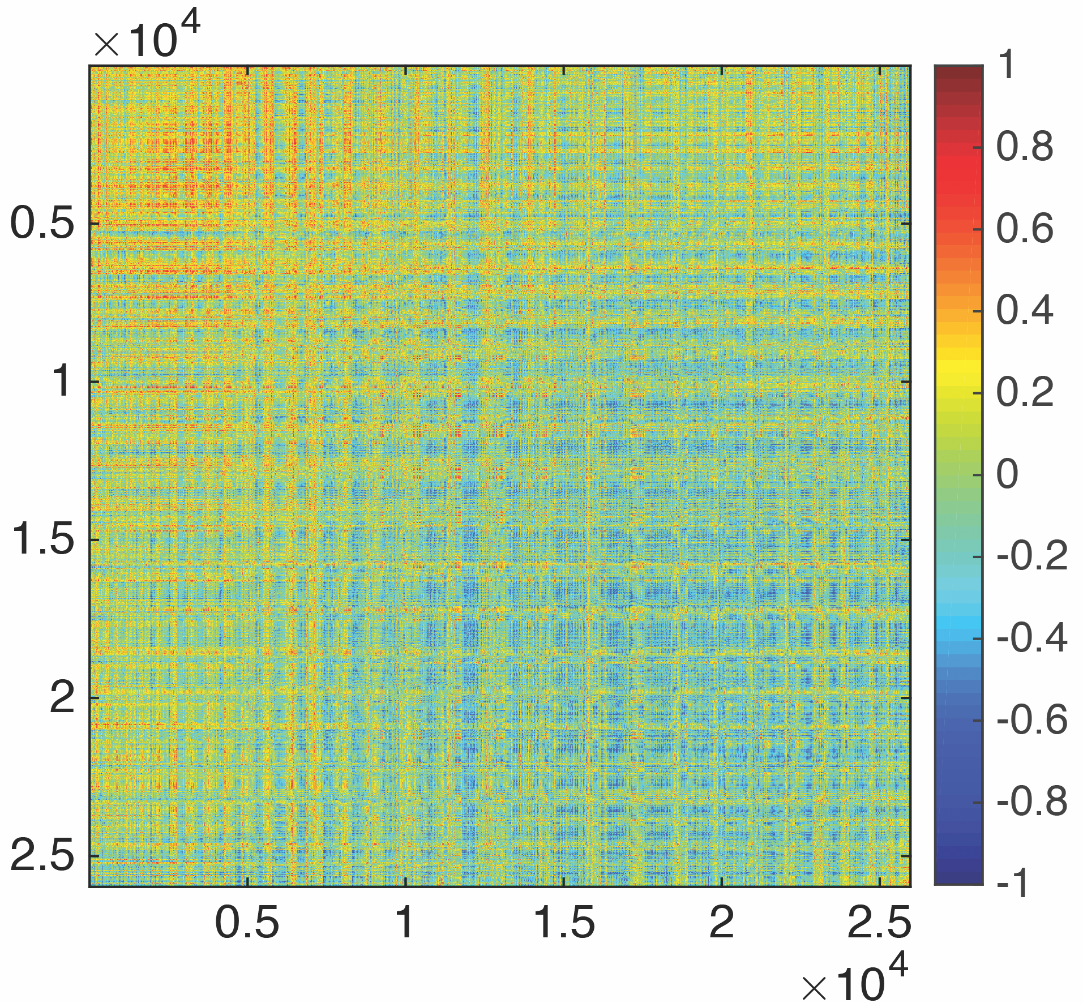
Brain connectivity analysis
46
53
connectivity
63
p=25972 voxels (3mm) in the brain
25972 x 25972 = 0.67 billion connections
5.2GB memory, 6min to load/save to a hard drive
Notes:
Our method: 18 sec. computation

Slide 13
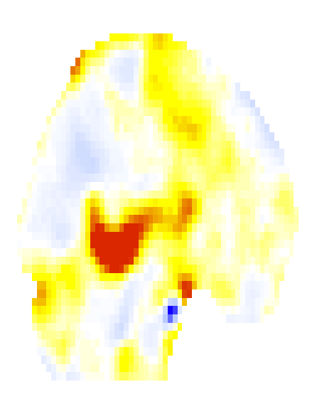
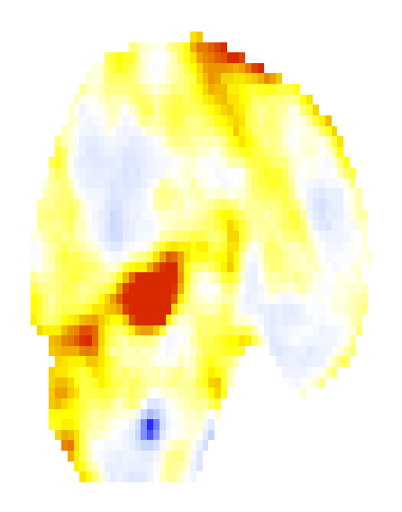
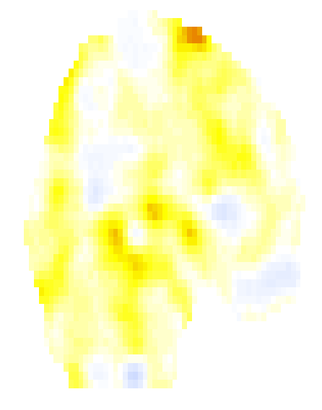
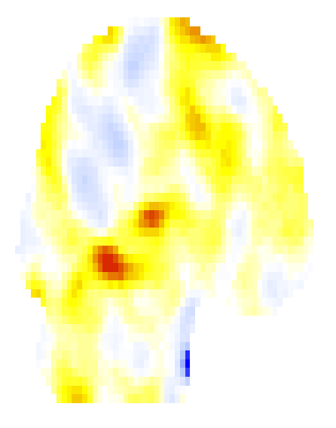

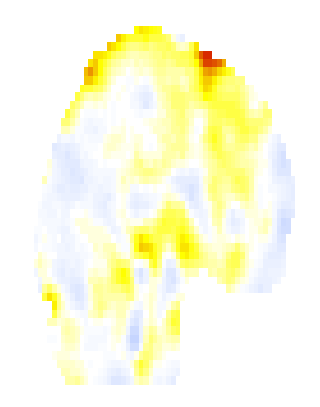
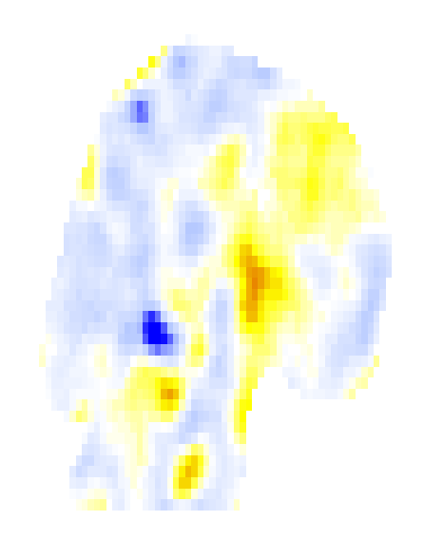
Hyper-network across paired images

Slide 14
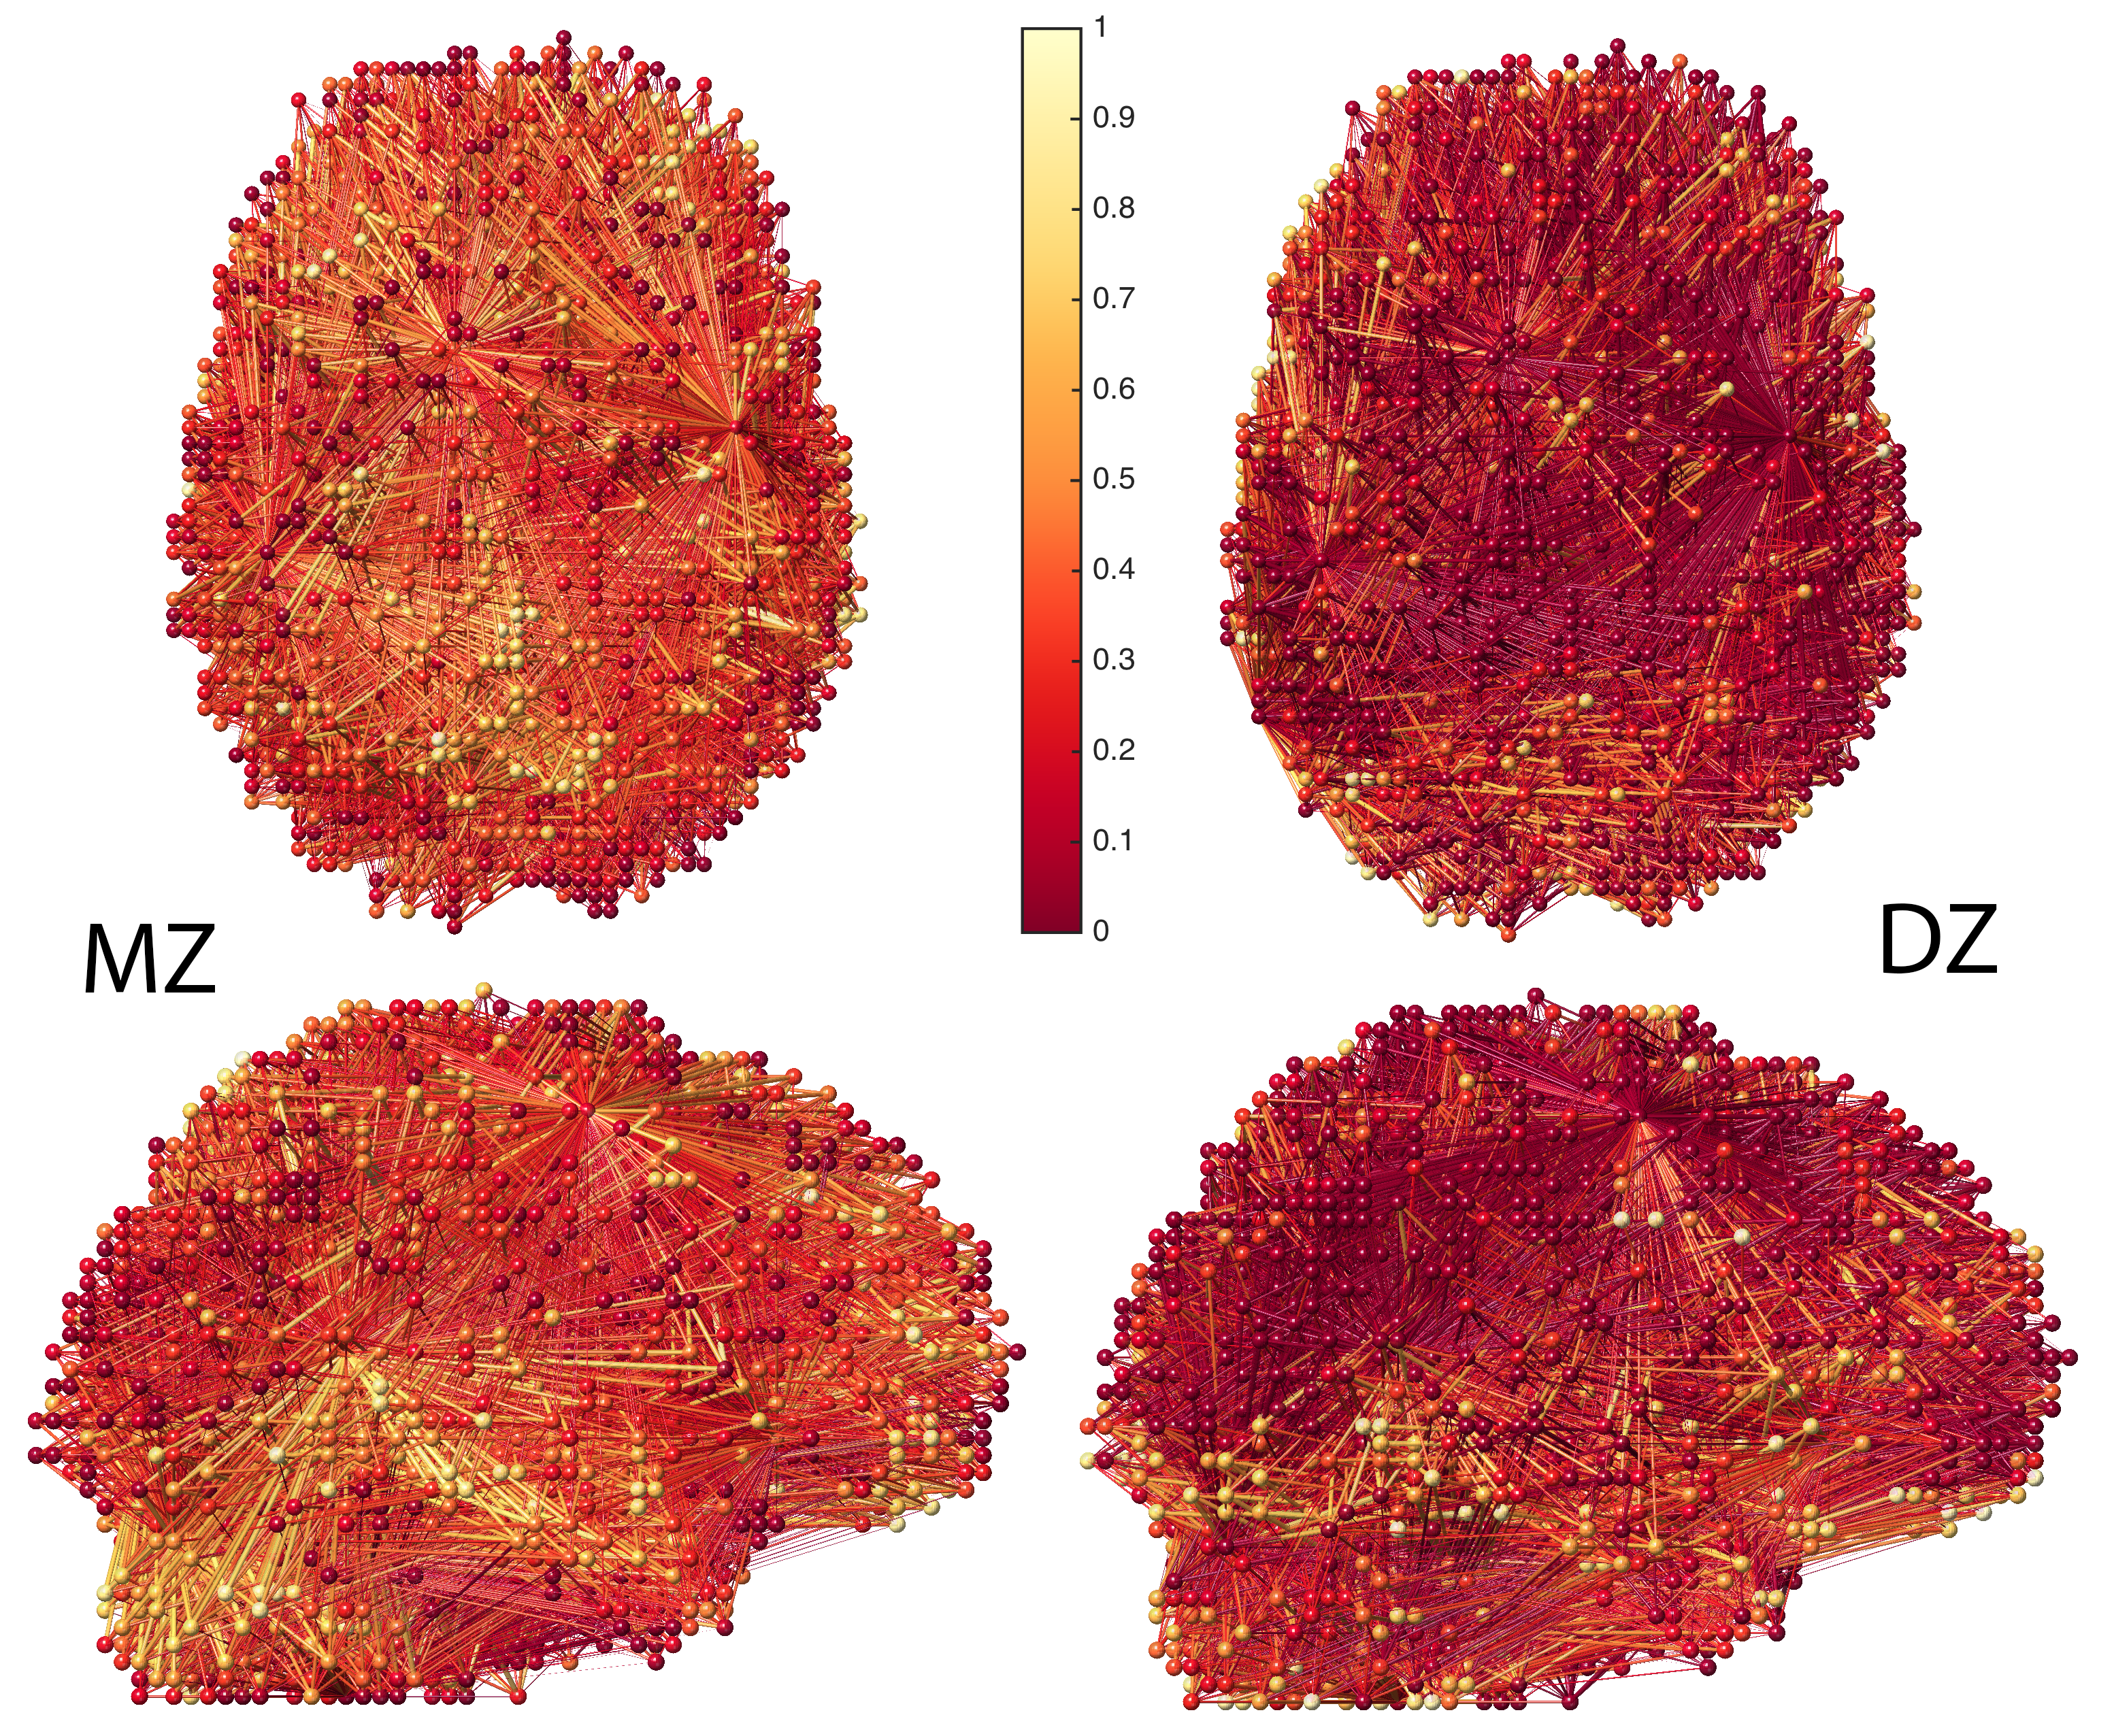
Dense connections
Least squares
Estimation
cross-correlation
Notes:
How to analyze?

Slide 15
Sparse network model
0.4
2
0.1
2
1
1
-0.1
λ=0.3
0.5
0.3
0.2
-0.7
-0.4
3
3
4
0.9
4
0.6
2
1
Binarization
3
4

Slide 16
Optimal sparse parameter?
0.4
0.1
2
2
2
1
1
1
-0.1
0.5
0.3
0.2
-0.7
-0.4
-0.2
3
3
3
4
0.9
4
0.6
4
0.4
Topological structure of network changes depending
on the choice of sparse parameter.

Slide 17
Filtration on sparse binary networks
0.4
0.1
2
2
2
1
1
1
-0.1
0.5
0.3
0.2
-0.7
-0.4
-0.2
3
3
3
4
0.9
4
0.6
4
0.4
2
2
2
1
1
1
3
3
3
4
4
4

Slide 18
Filtration on model parameters
Theorem 1.
Collection of binary sparse models:
Monotonicity property
for
Chung et al. 2017 Information Processing in Medical Imaging, accepted

Slide 19
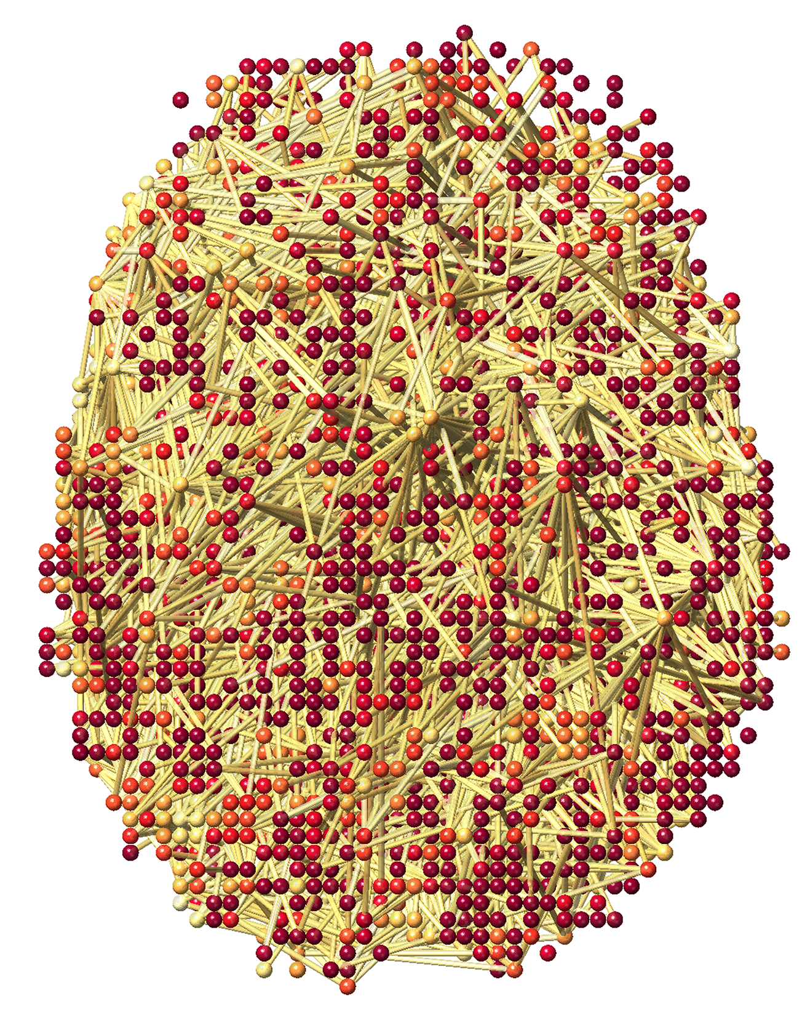
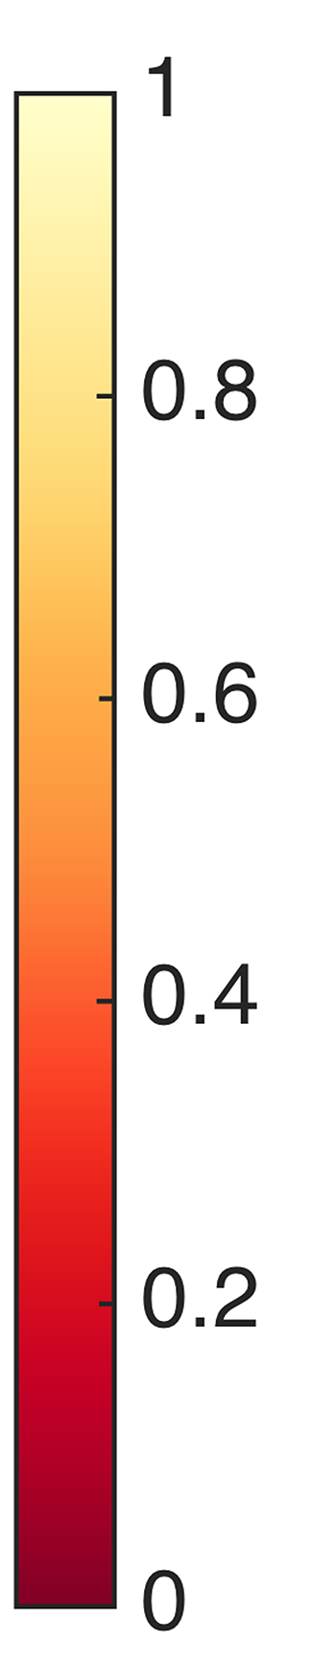
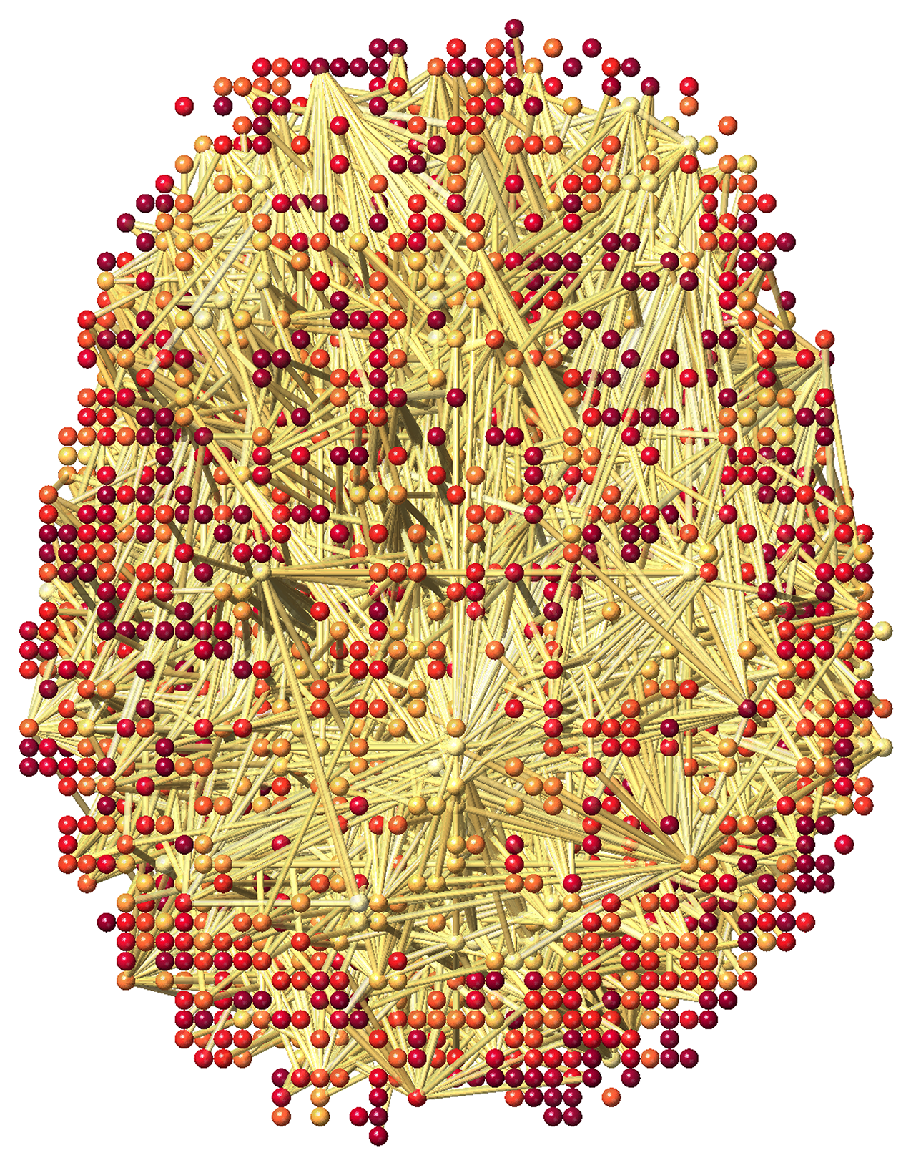
Networks at sparse parameter 0.7
MZ-twins
DZ-twins
Notes:
More higher correlations for MZ

Slide 20
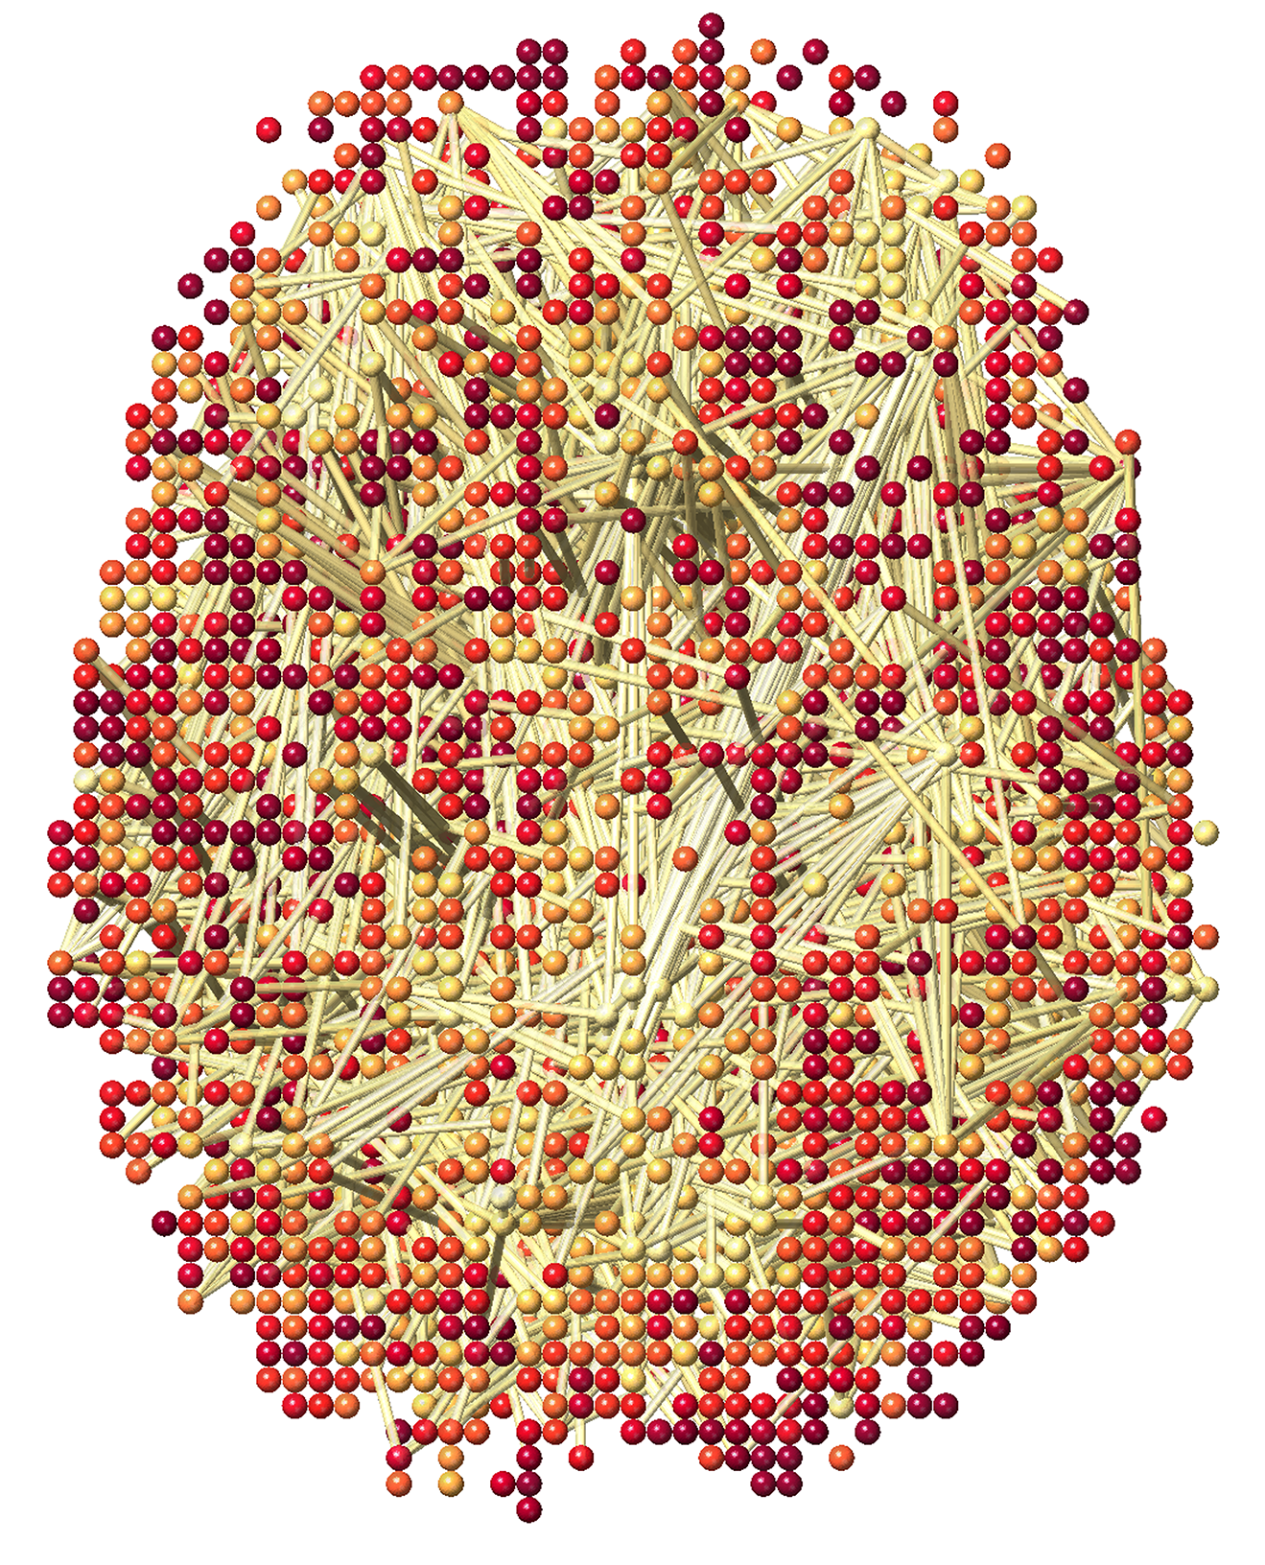
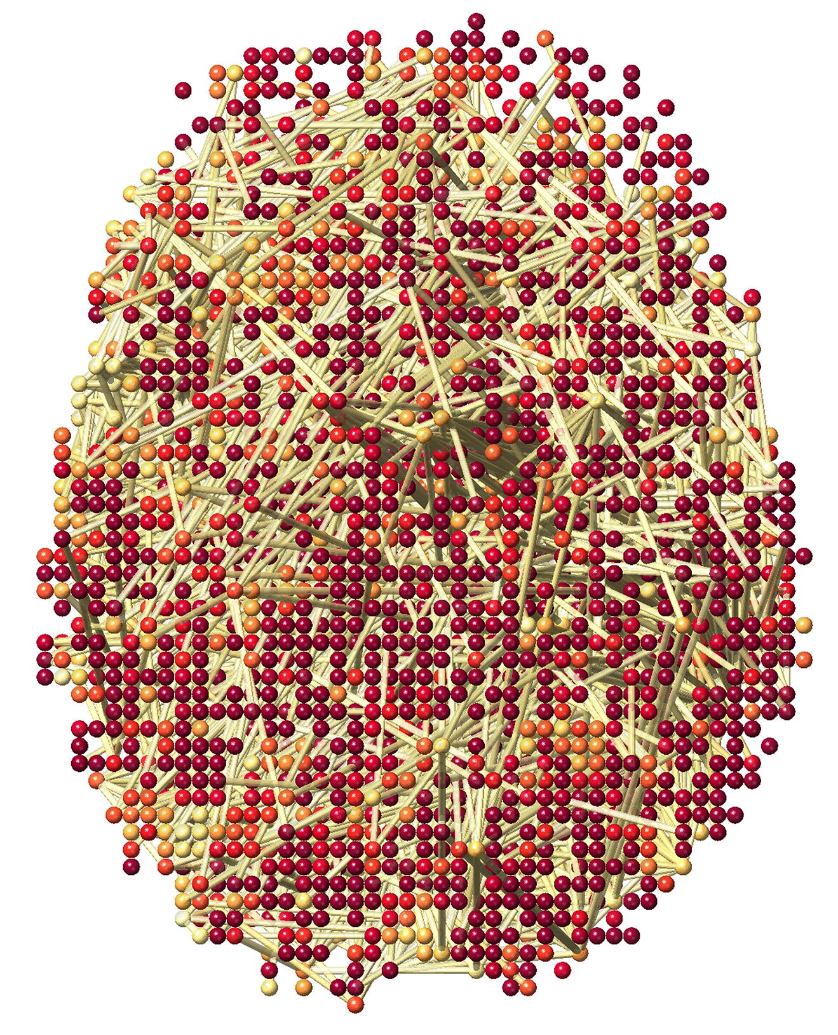
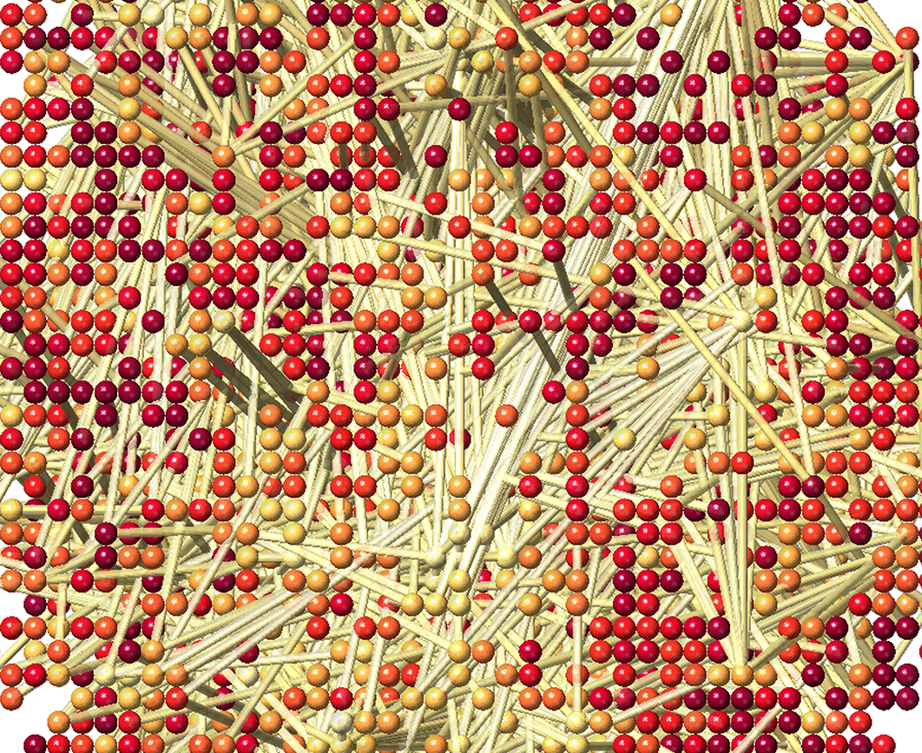
Networks at sparse parameter 0.8
MZ-twins
DZ-twins
Notes:
More higher correlations for MZ

Slide 21
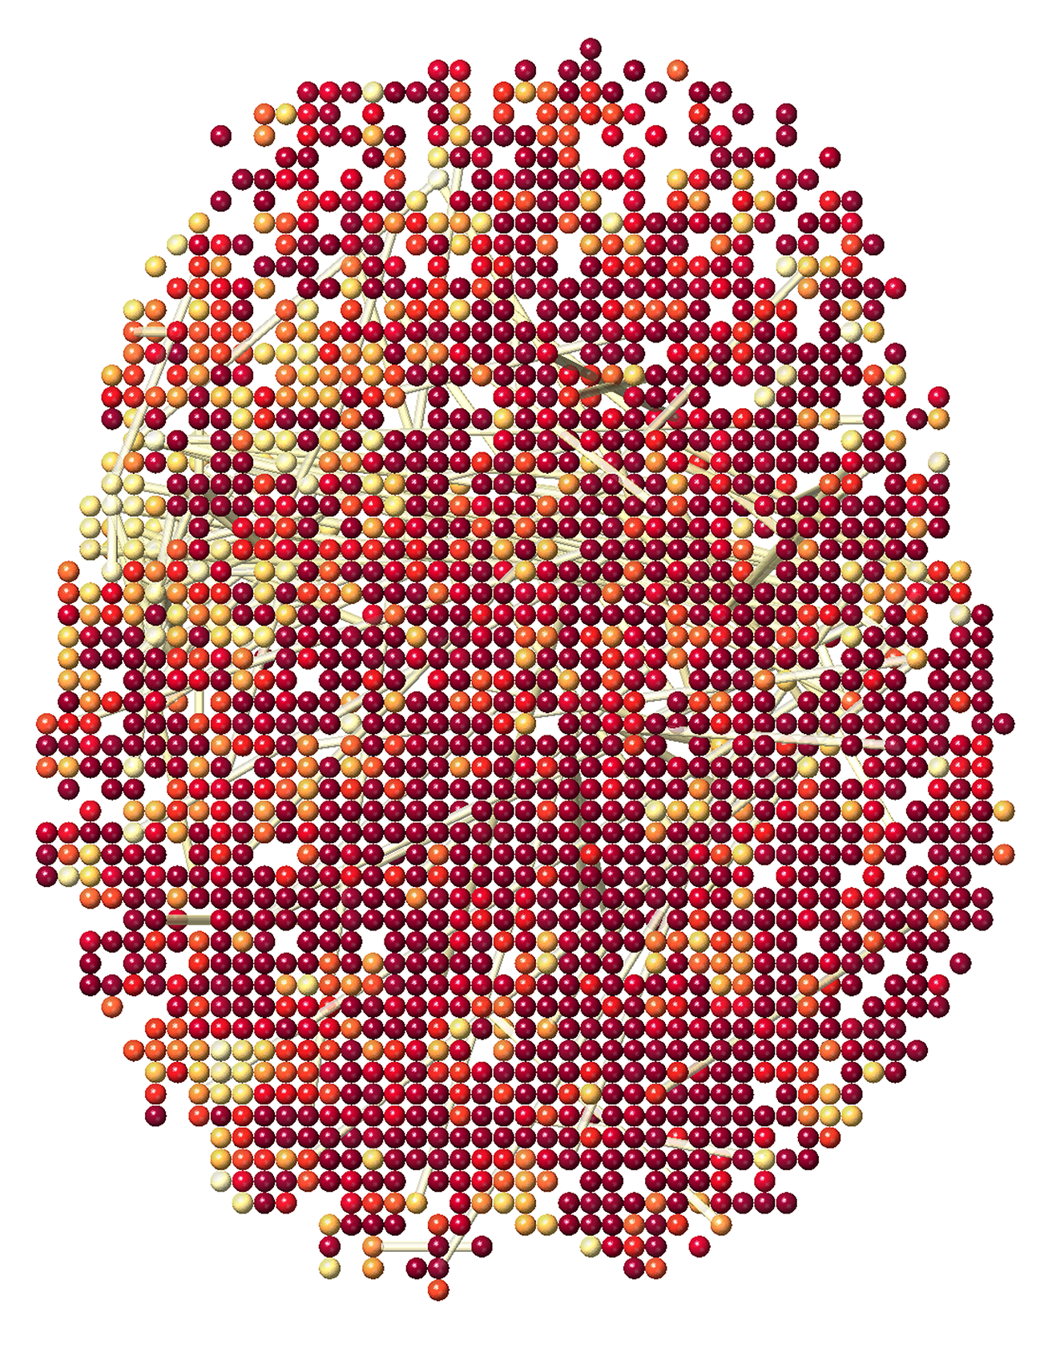
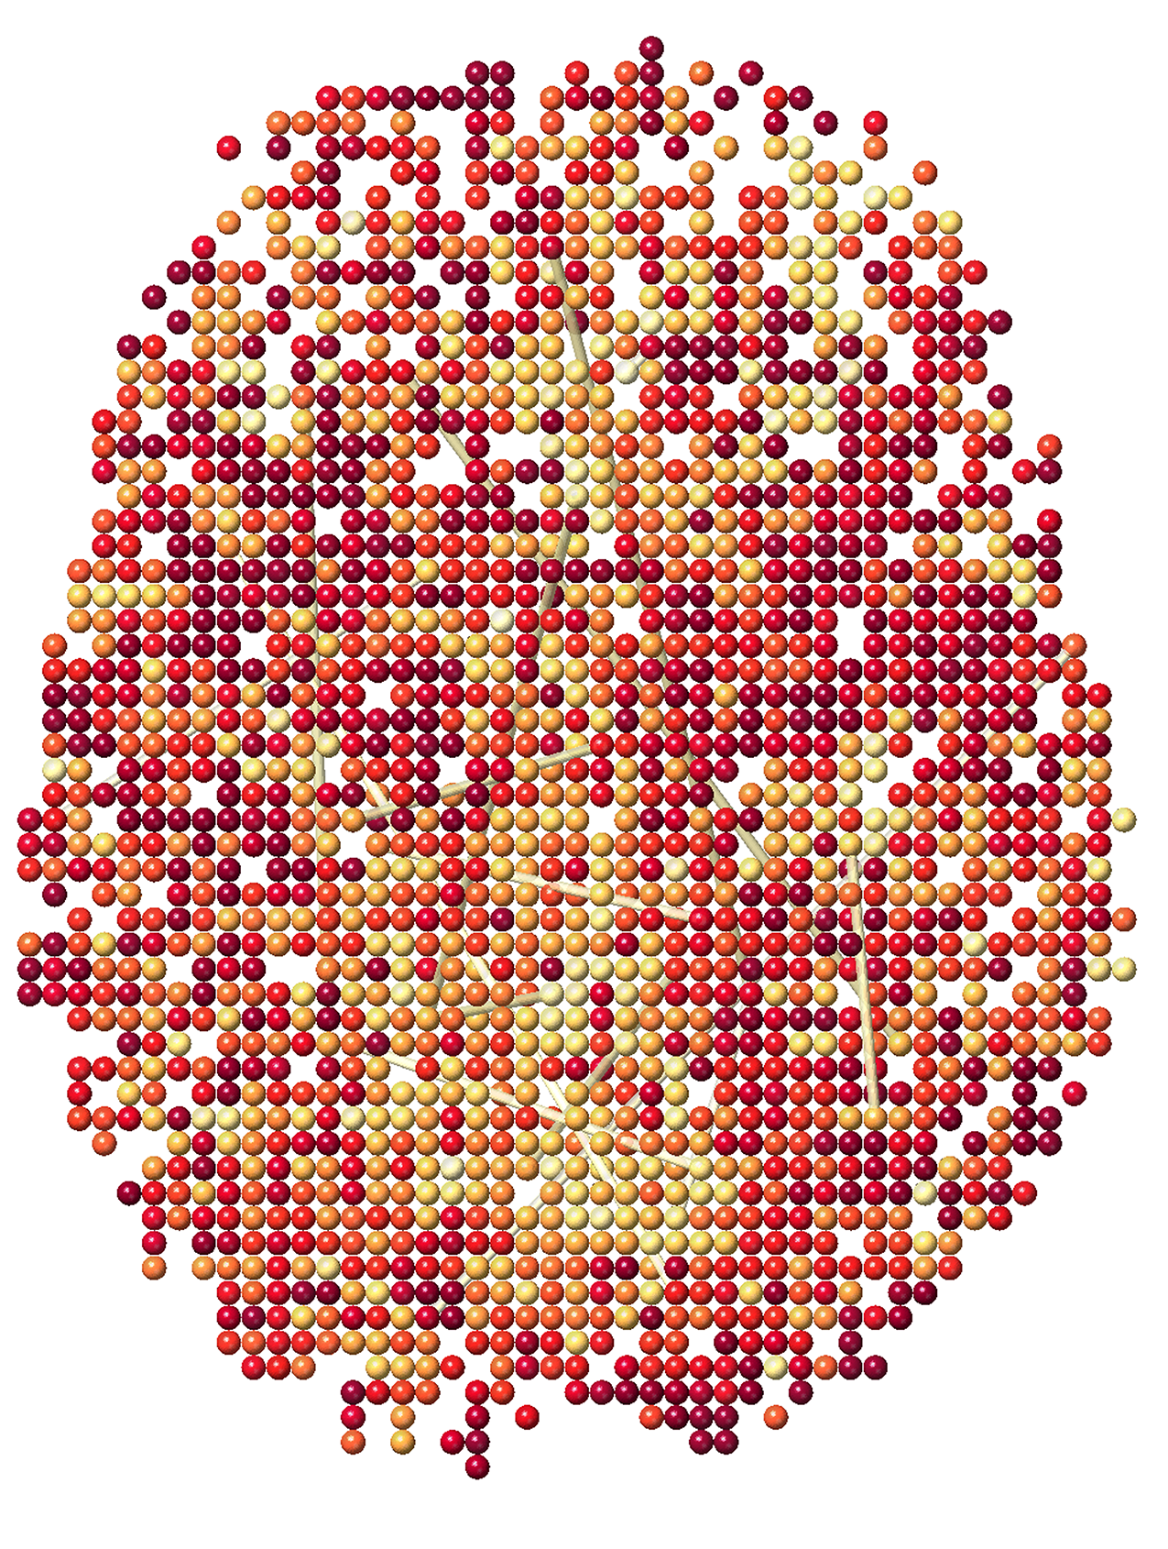
Networks at sparse parameter 0.9
MZ-twins
DZ-twins
Notes:
More higher correlations for MZ

Slide 22
Exact Topological Inference

Slide 23
0.4
0.5
0.7
0.1
0.3
0.9
Number of connected components
3
2
1
0
0
0.1
0.3
0.4
0.5
Size of the largest connected components
4
3
2
1
0
0.1
0.3
0.4
0.5

Slide 24
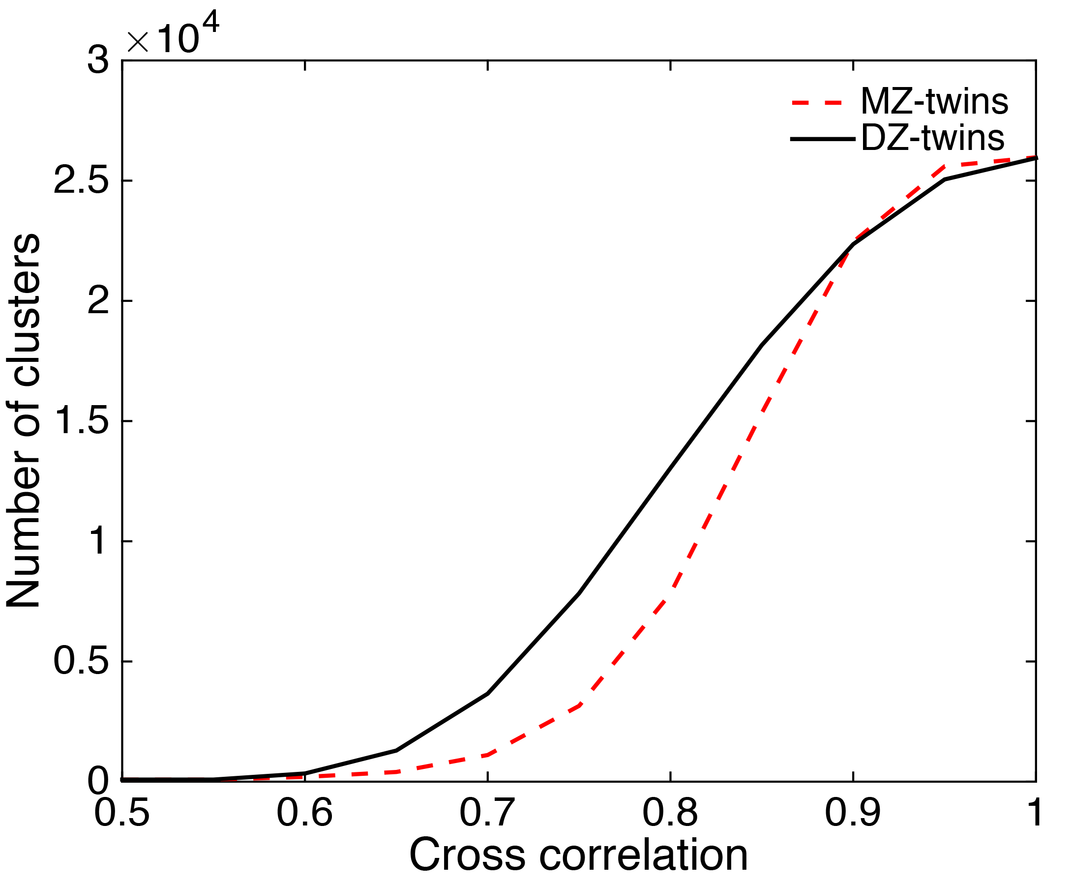
Distance between networks
Sparse parameter
p-value < 0.0002
Notes:
MZ-twins have more clusters of higher correlations

Slide 25
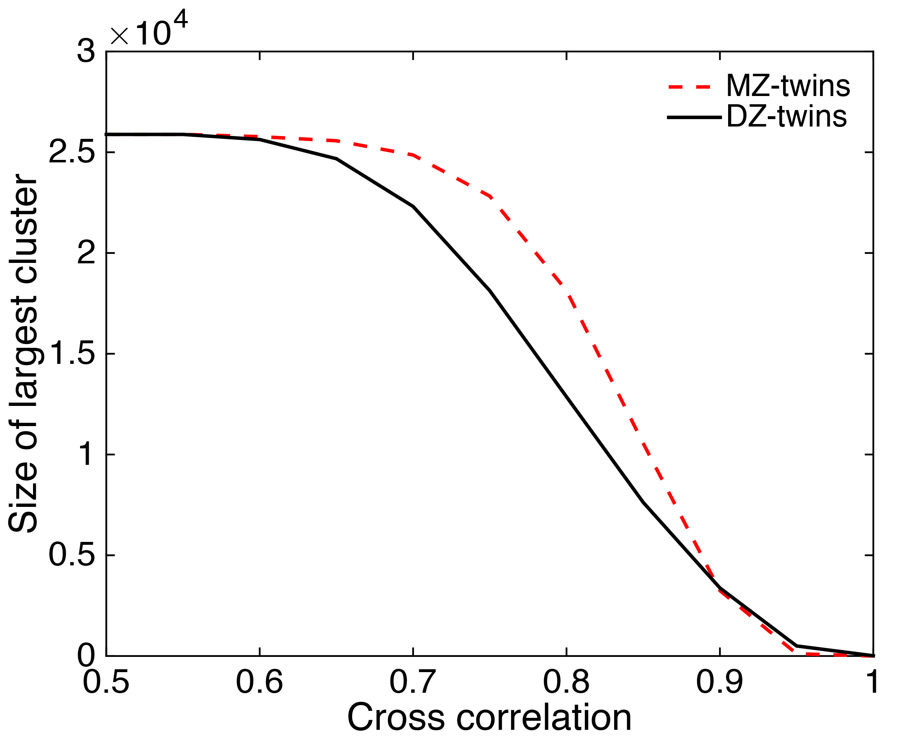
Size of the largest connected components
Sparse parameter
p-value < 0.0001
Notes:
MZ-twins have more clusters of higher correlations

Slide 26
Almost metric-like distance
Satisfies all the axioms of metric except identity:
does not imply
However,

Slide 27
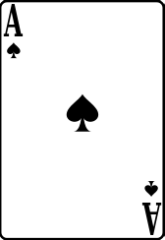
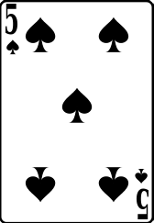
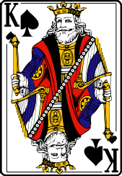
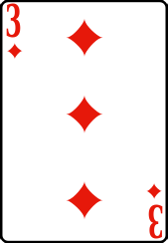
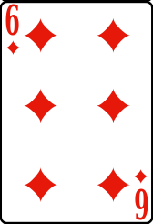
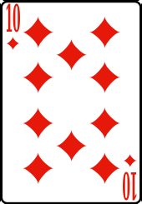
Permutation test
Observed
d=3
Player 1
Player 2
Permuted
d=3
Permuted
d=4

Slide 28
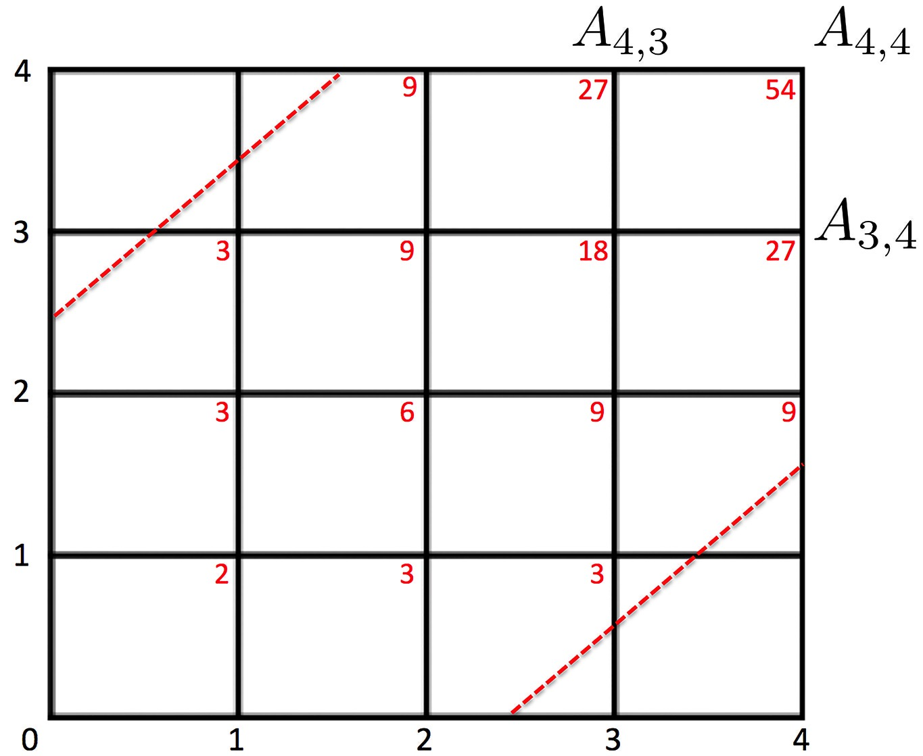
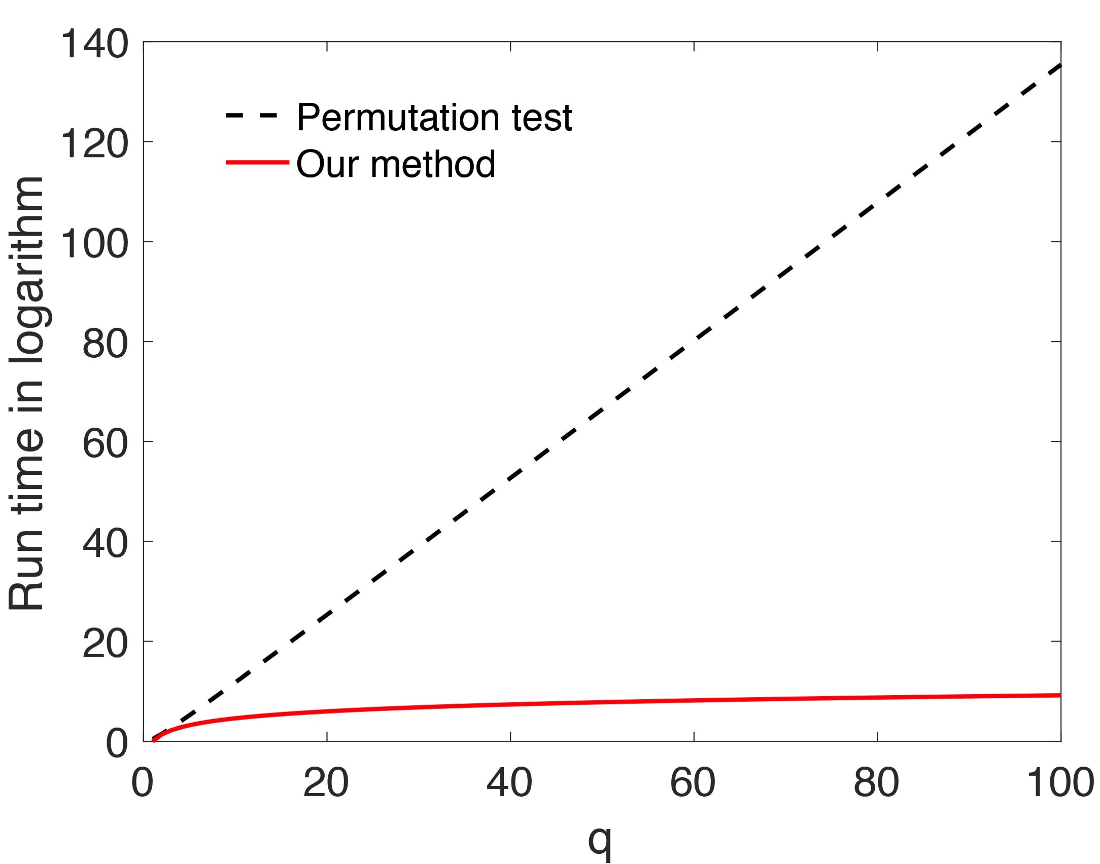
Exact topological inference
Theorem 2.
d

Slide 29
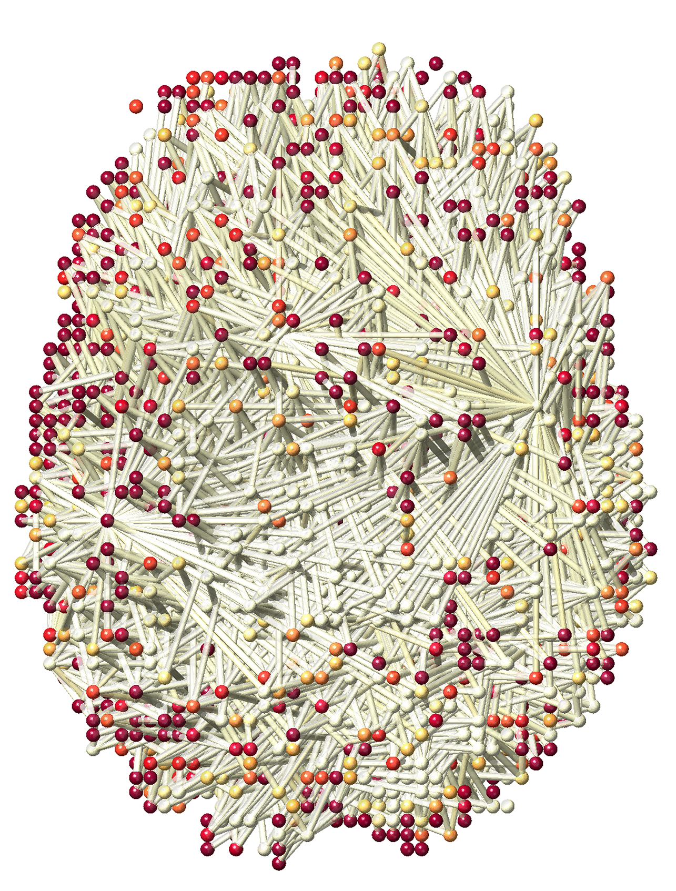
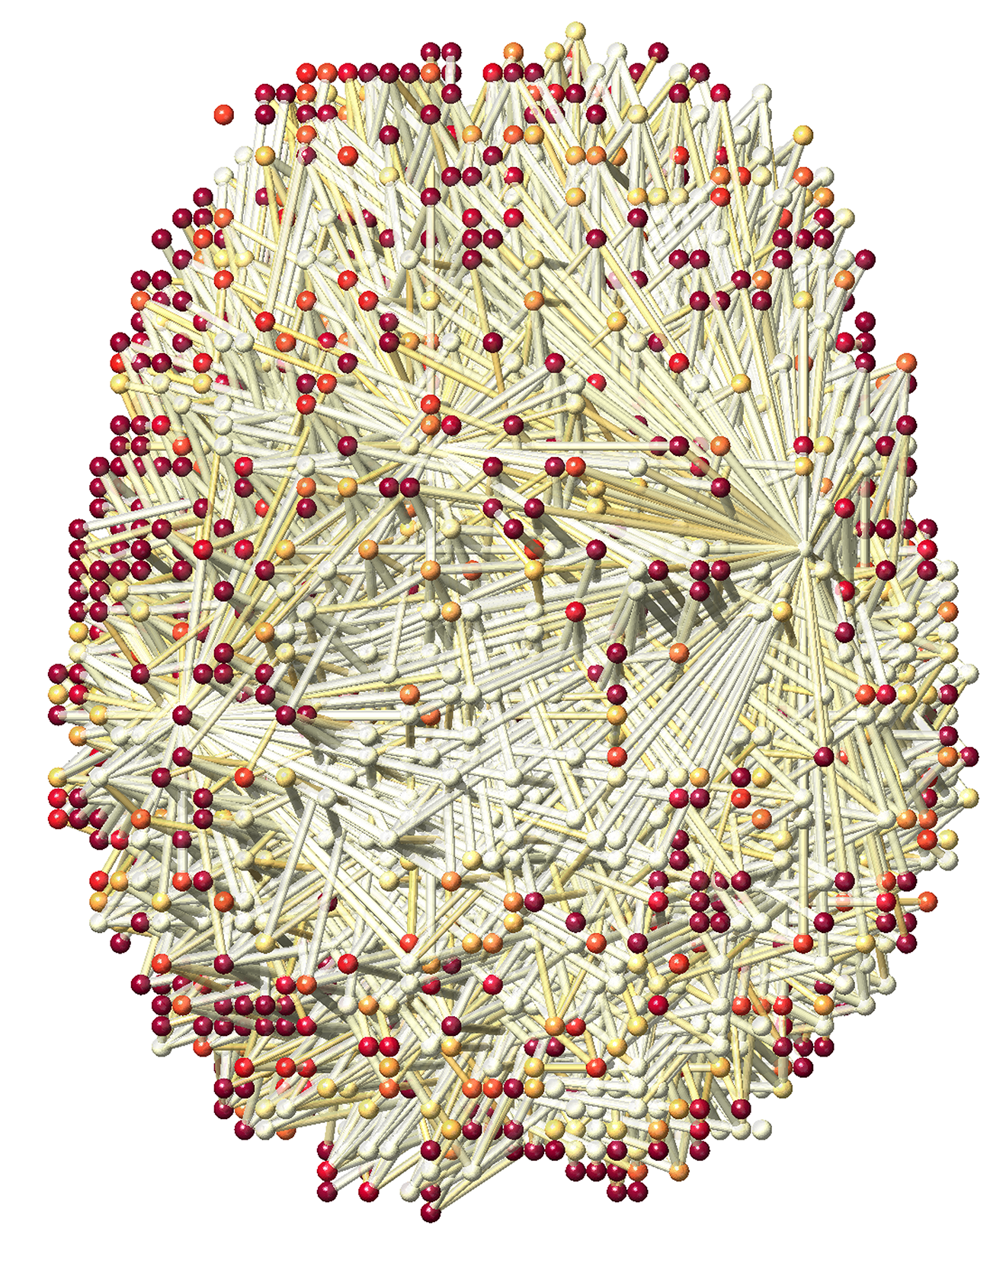
Heritability Index (both nodes and edges)
Sparse parameter 0.7
Sparse parameter 0.9
p-value < 0.0002
Notes:
More higher correlations for MZ

Slide 30
Thank you

