Slide 1


Multivariate Tensor-Based Morphometry and Its Application to Detecting White Matter Abnormality in Abused Children:
Persistent Homological Approach
Moo K. Chung
Waisman Laboratory for Brain Imaging and Behavior
University of Wisconsin-Madison
www.stat.wisc.edu/~mchung

Slide 2
Acknowledgements
Jamie Hanson, Richard Davidson, Seth Pollack
University of Wisconsin-Madison
Hyekyung Lee
Seoul National University
Brian Avants, James Gee
University of Pennsylvania

Slide 3
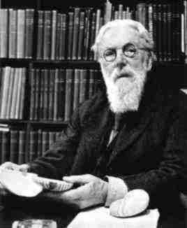
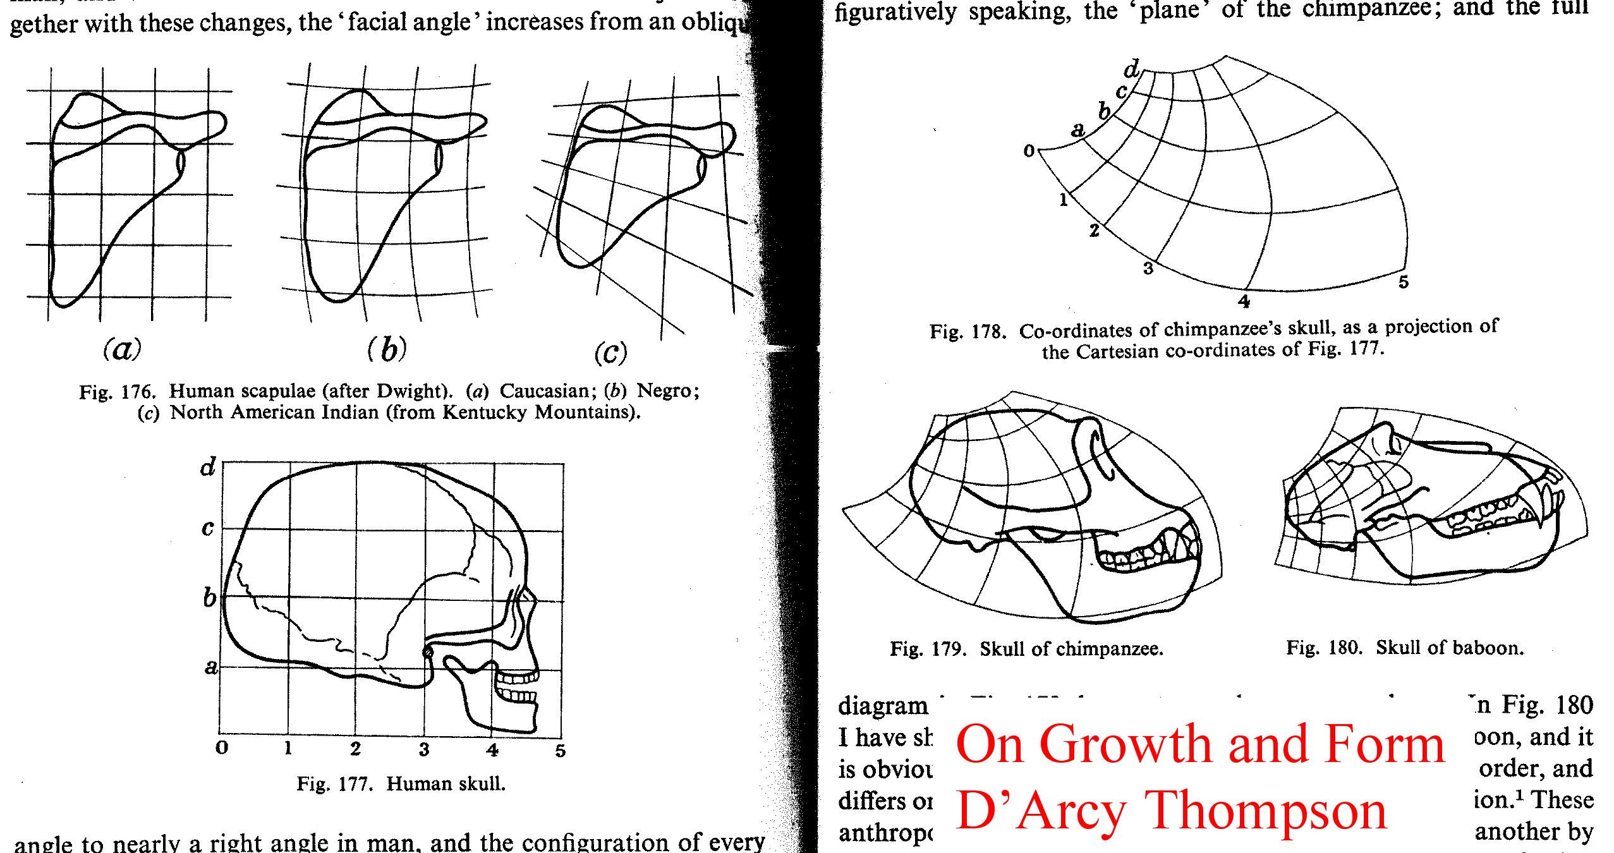
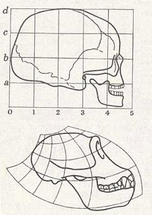
Deformable grid system
D’Arcy Thompson 1860-1948

Slide 4
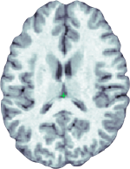
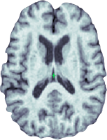
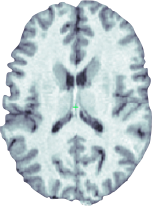

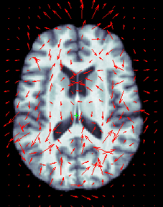
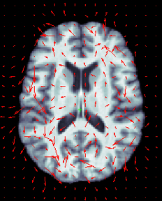
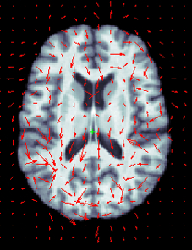
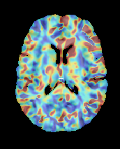
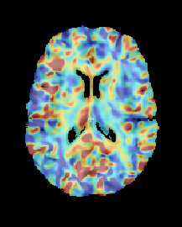
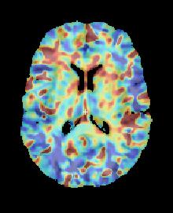



Jacobian determinant
displacement
vector
S.-G. Kim, Seoul National University

Slide 5

Hanson et al., 2010. Journal of Neuroscience 30:7466-7472

Slide 6

Hanson et al., 2012. Journal of Neuroscience 32:7917-7925

Slide 7
Multivariate-TBM

Slide 8
Data
T1-weighted MRI were collected using a 3T GE SIGNA scanner.
23 maltreated children who have been post-institutionalized (PI) in orphanages in East Europe and China but later adopted to the families in US.
Age-matched 31 normal control subjects.
Age: PI : 11.26 +- 1.71, Controls : 11.58 +- 1.61 years.
Gender PI: 10 boys and 13 girls, Controls: 18 boys and 13 girls.

Slide 9
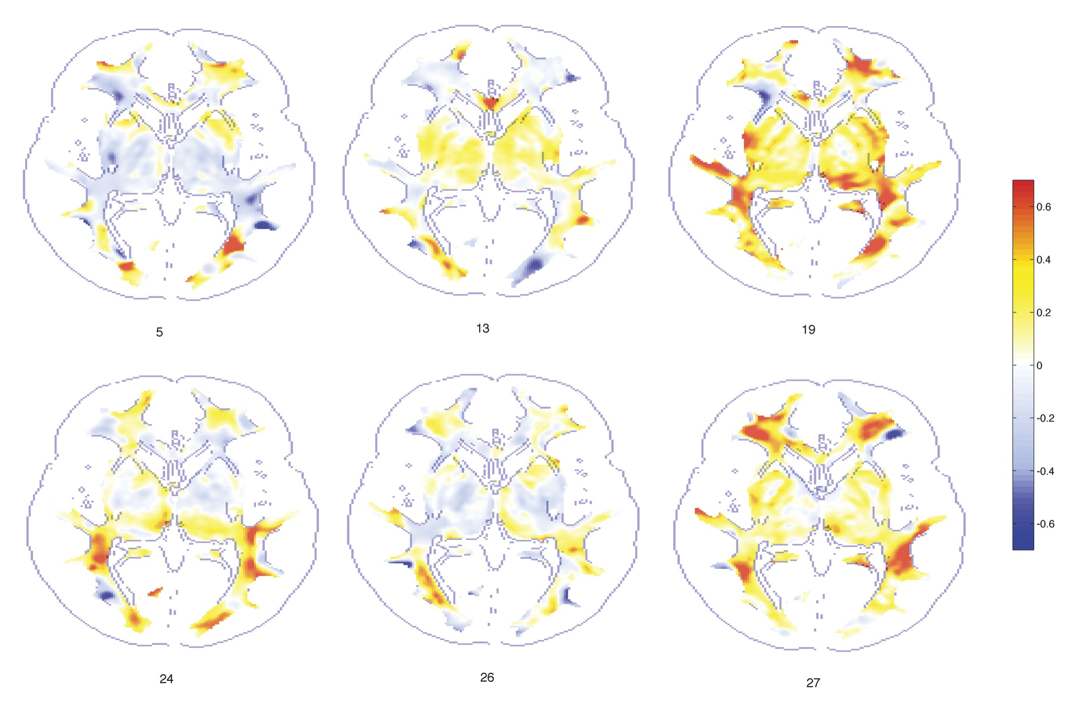
Jacobian determinant (tissue volume change) with respect to the template

Slide 10

Massive univariate vs. multivariate
Region A
univariate
multivariate
Region B
univariate
Group 1
Group 2

Slide 11
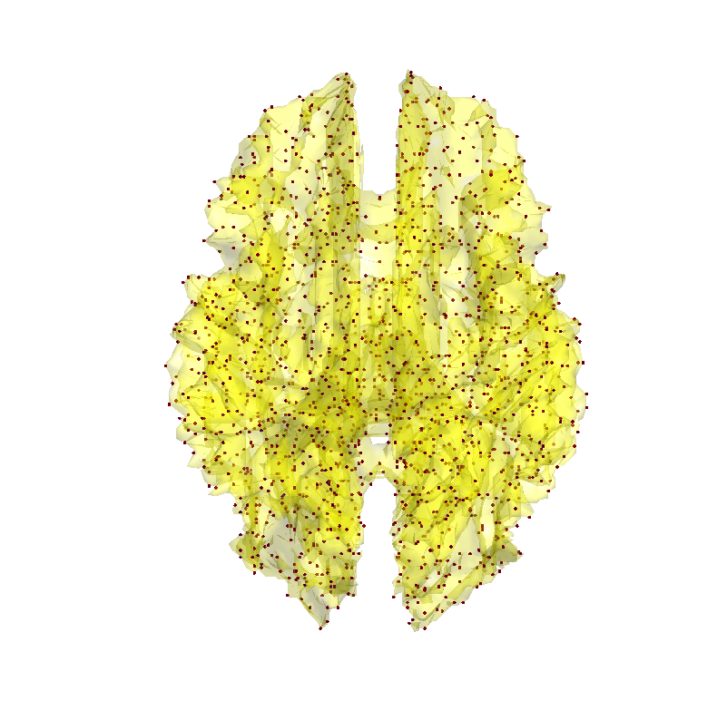
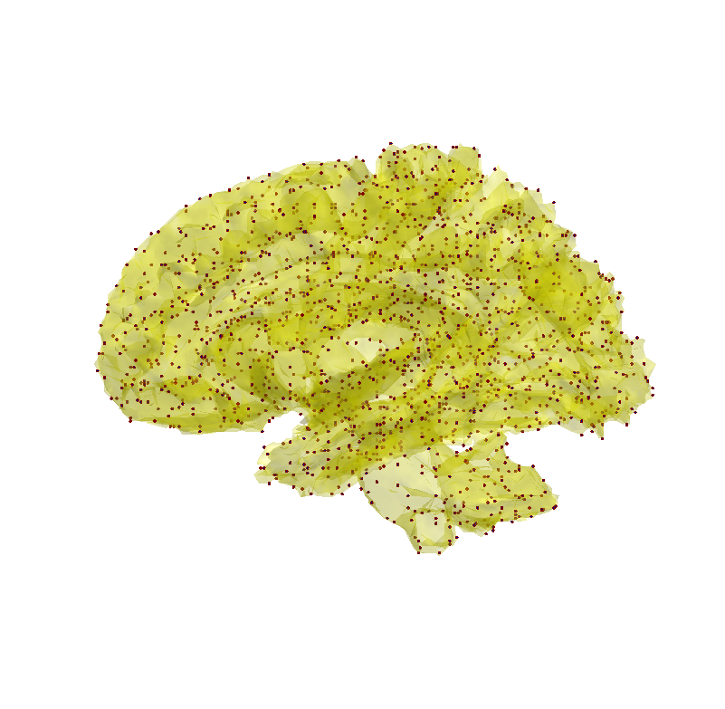
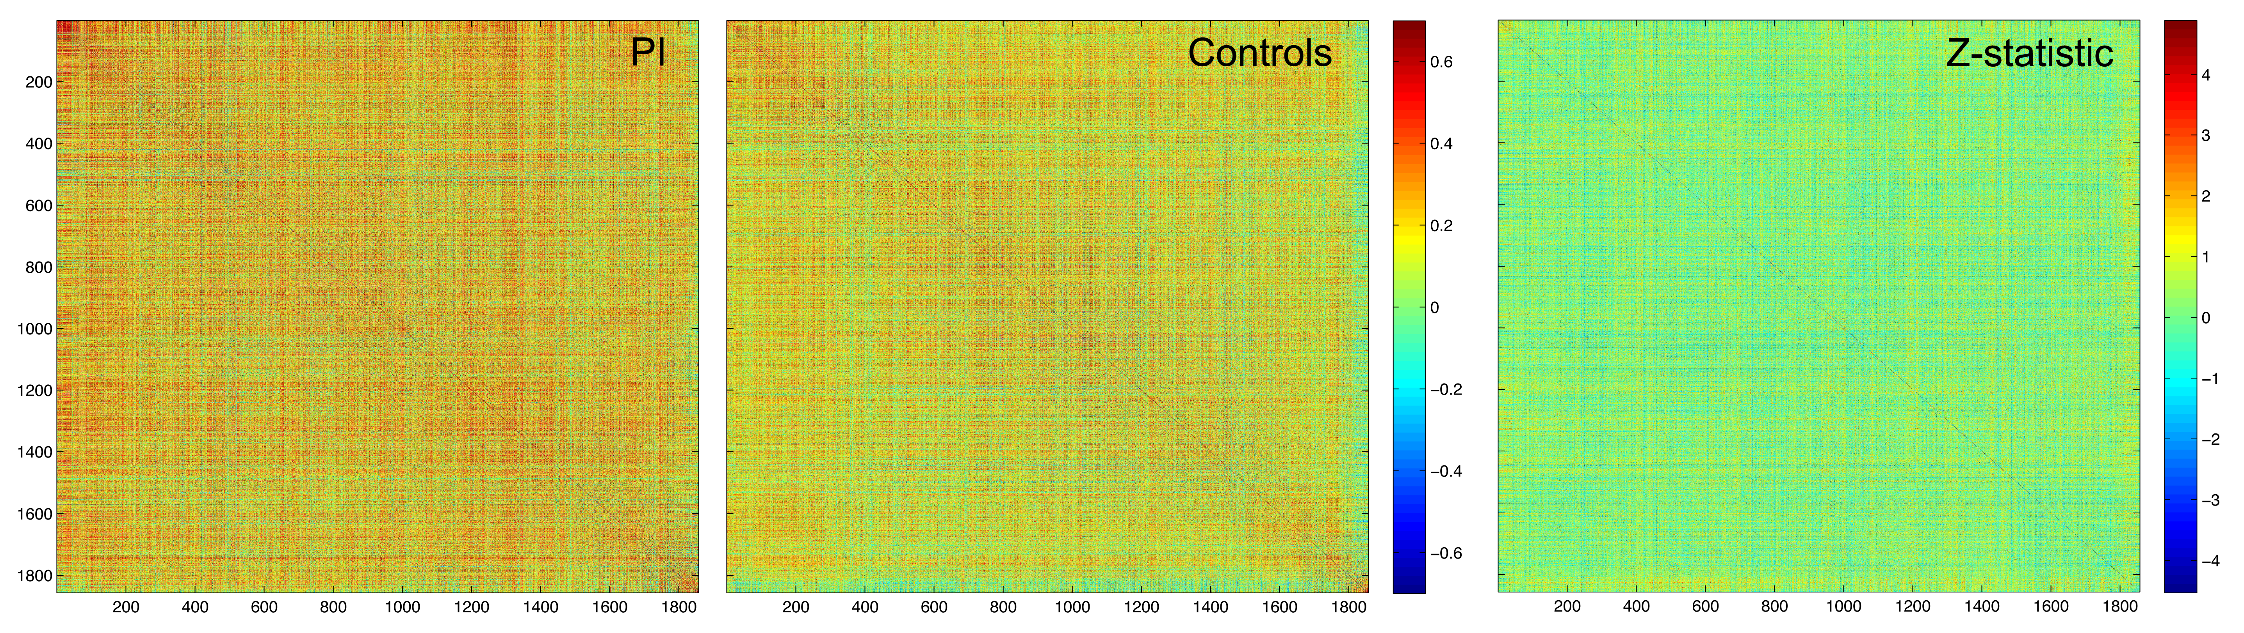
Correlation map of Jacobian determinants
1856 nodes correlation

Slide 12
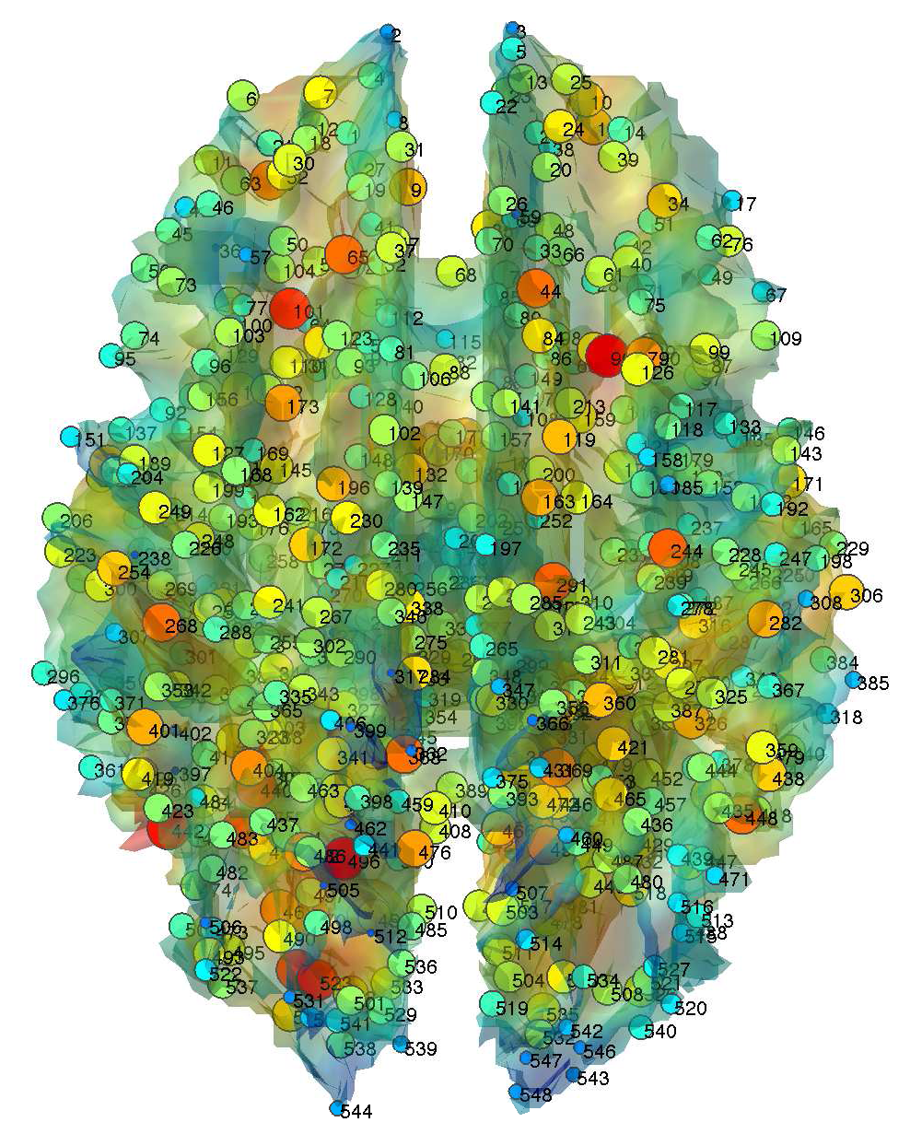
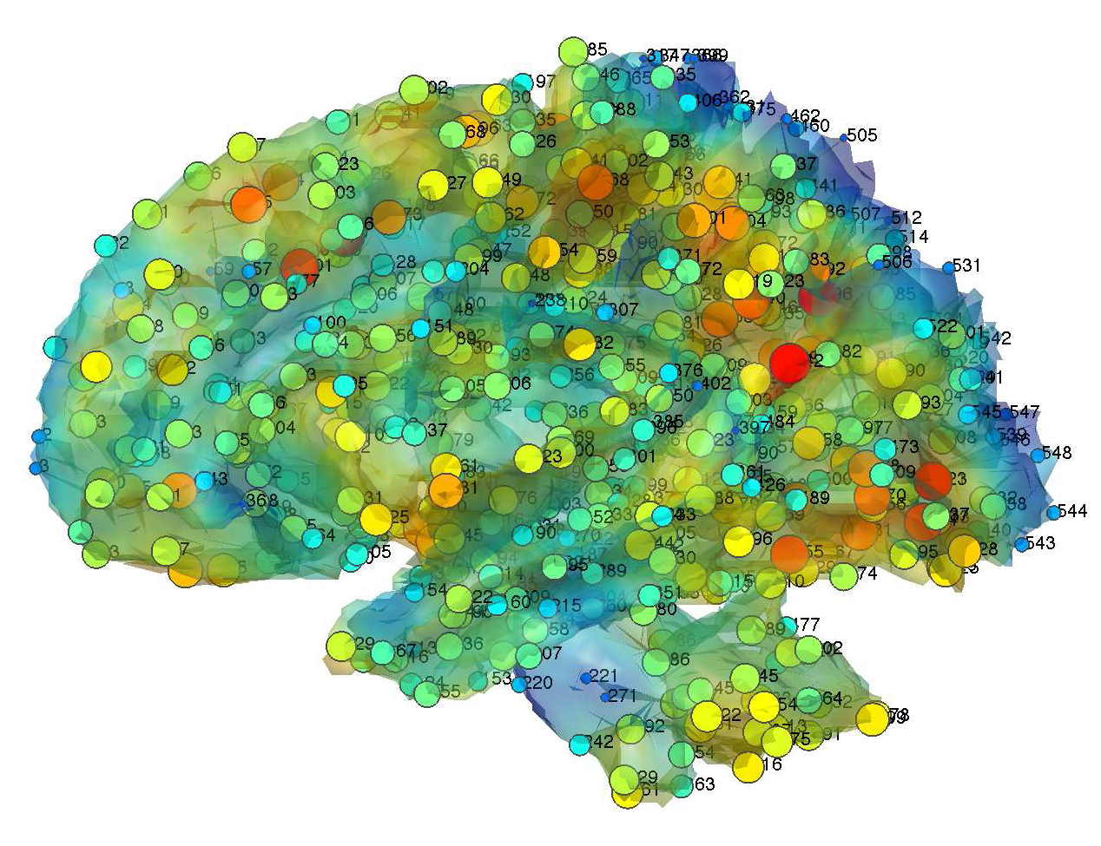
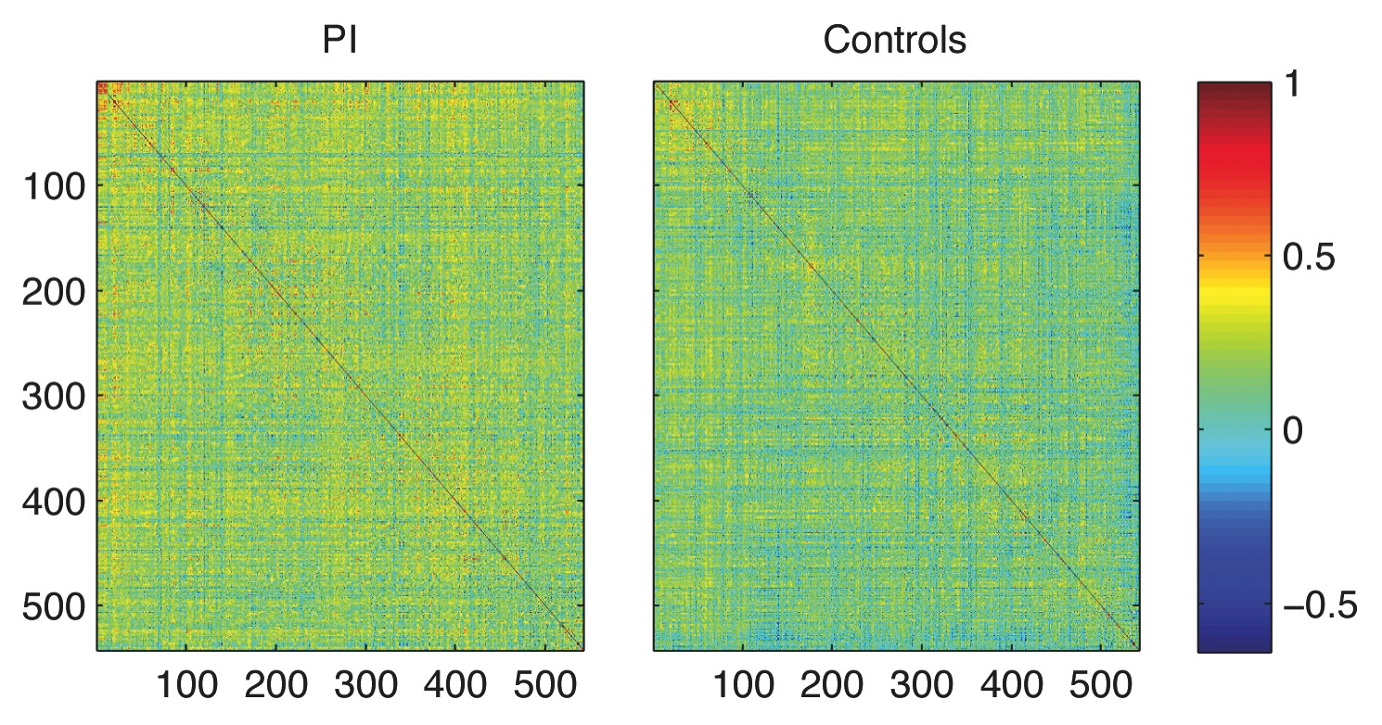
Correlation map of Jacobian determinants
15.7mm internodal distance
548 nodes correlation

Slide 13
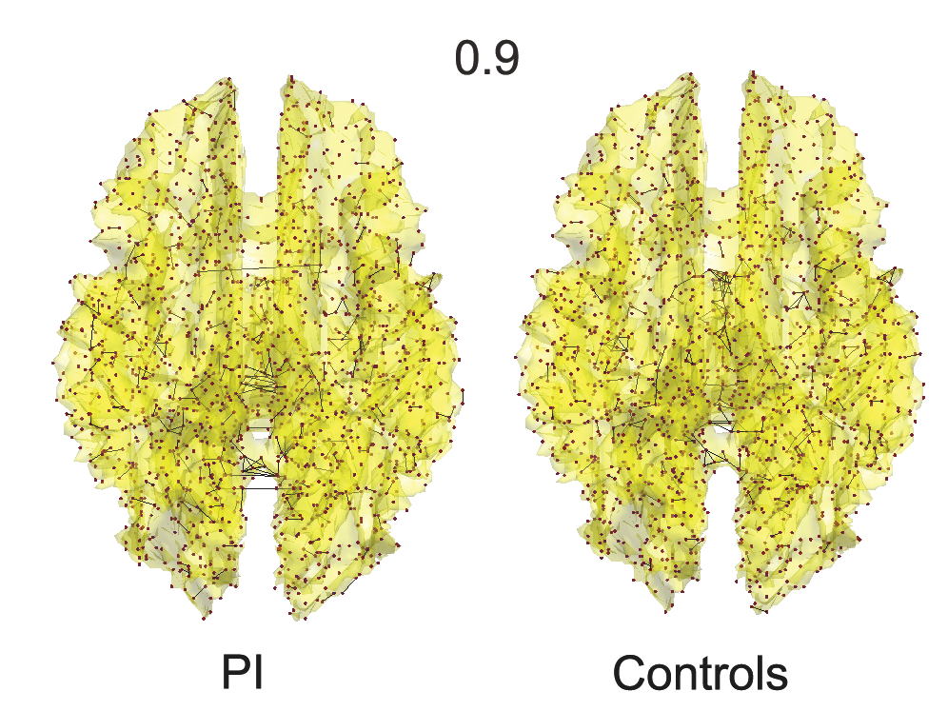
Graph representation of thresholded correlation

Slide 14
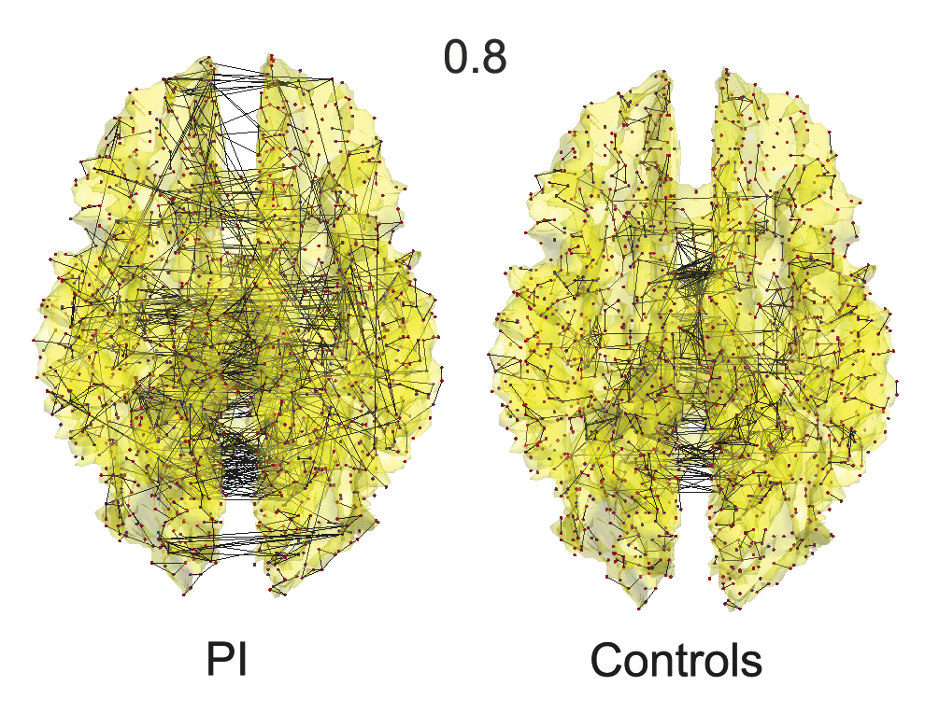
Graph representation of thresholded correlation

Slide 15
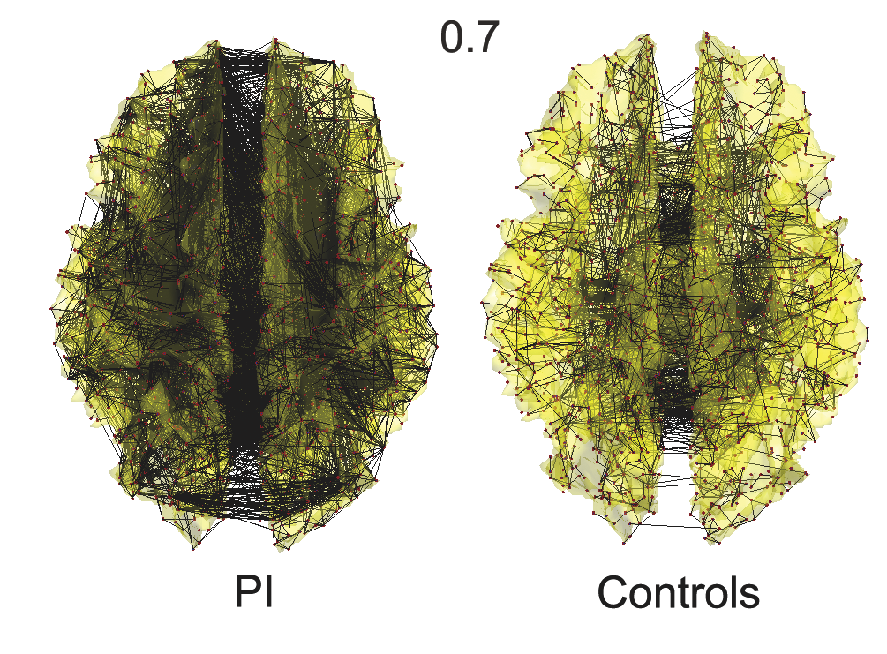
Graph representation of thresholded correlation
Interpretation: PI is structurally more homogenous than the controls.

Slide 16
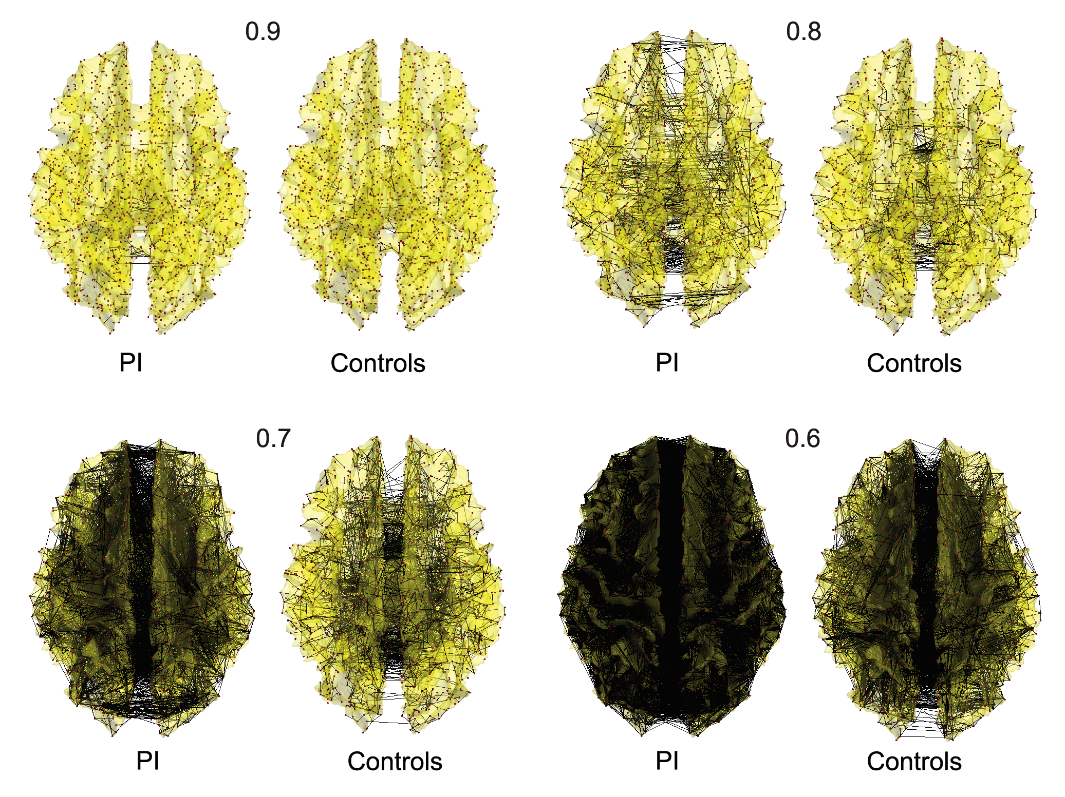
1856 nodes thresholding

Slide 17
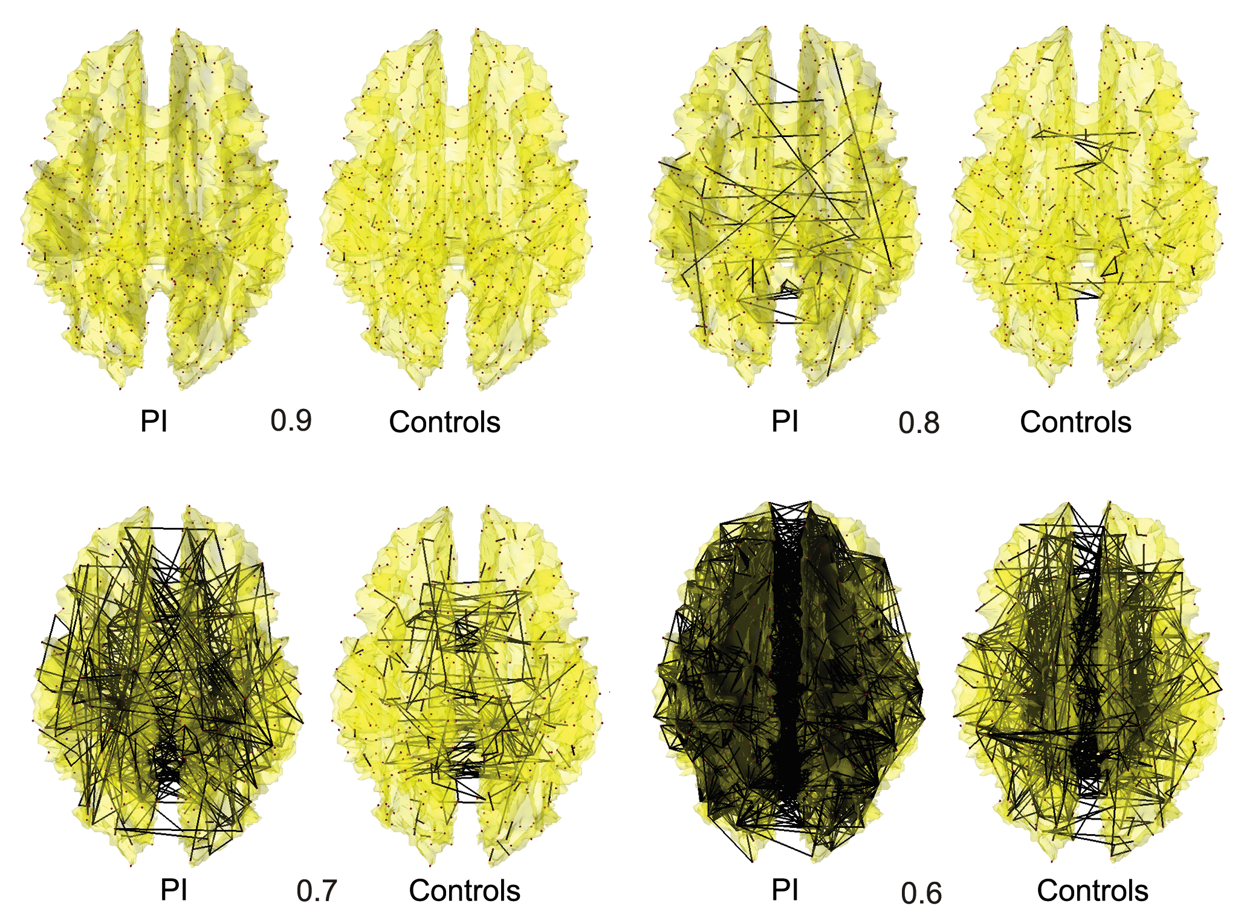
548 nodes thresholding

Slide 18
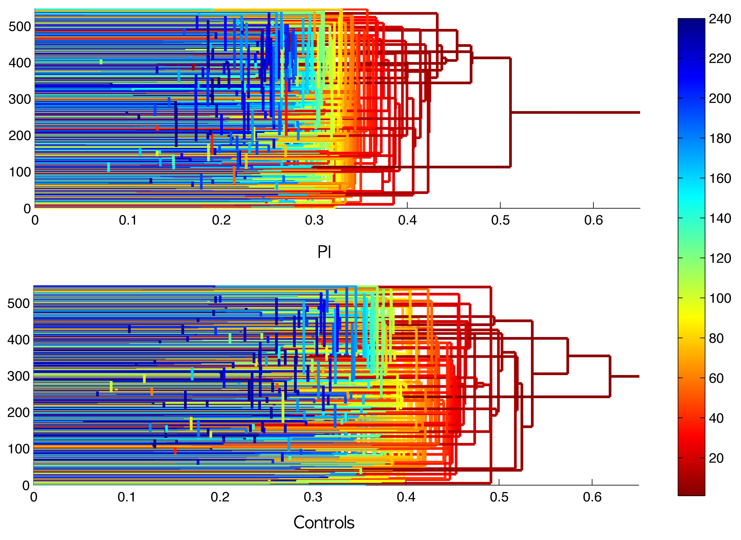
Dendrogram representation on 1- correlations
Correlation 0.6

Slide 19
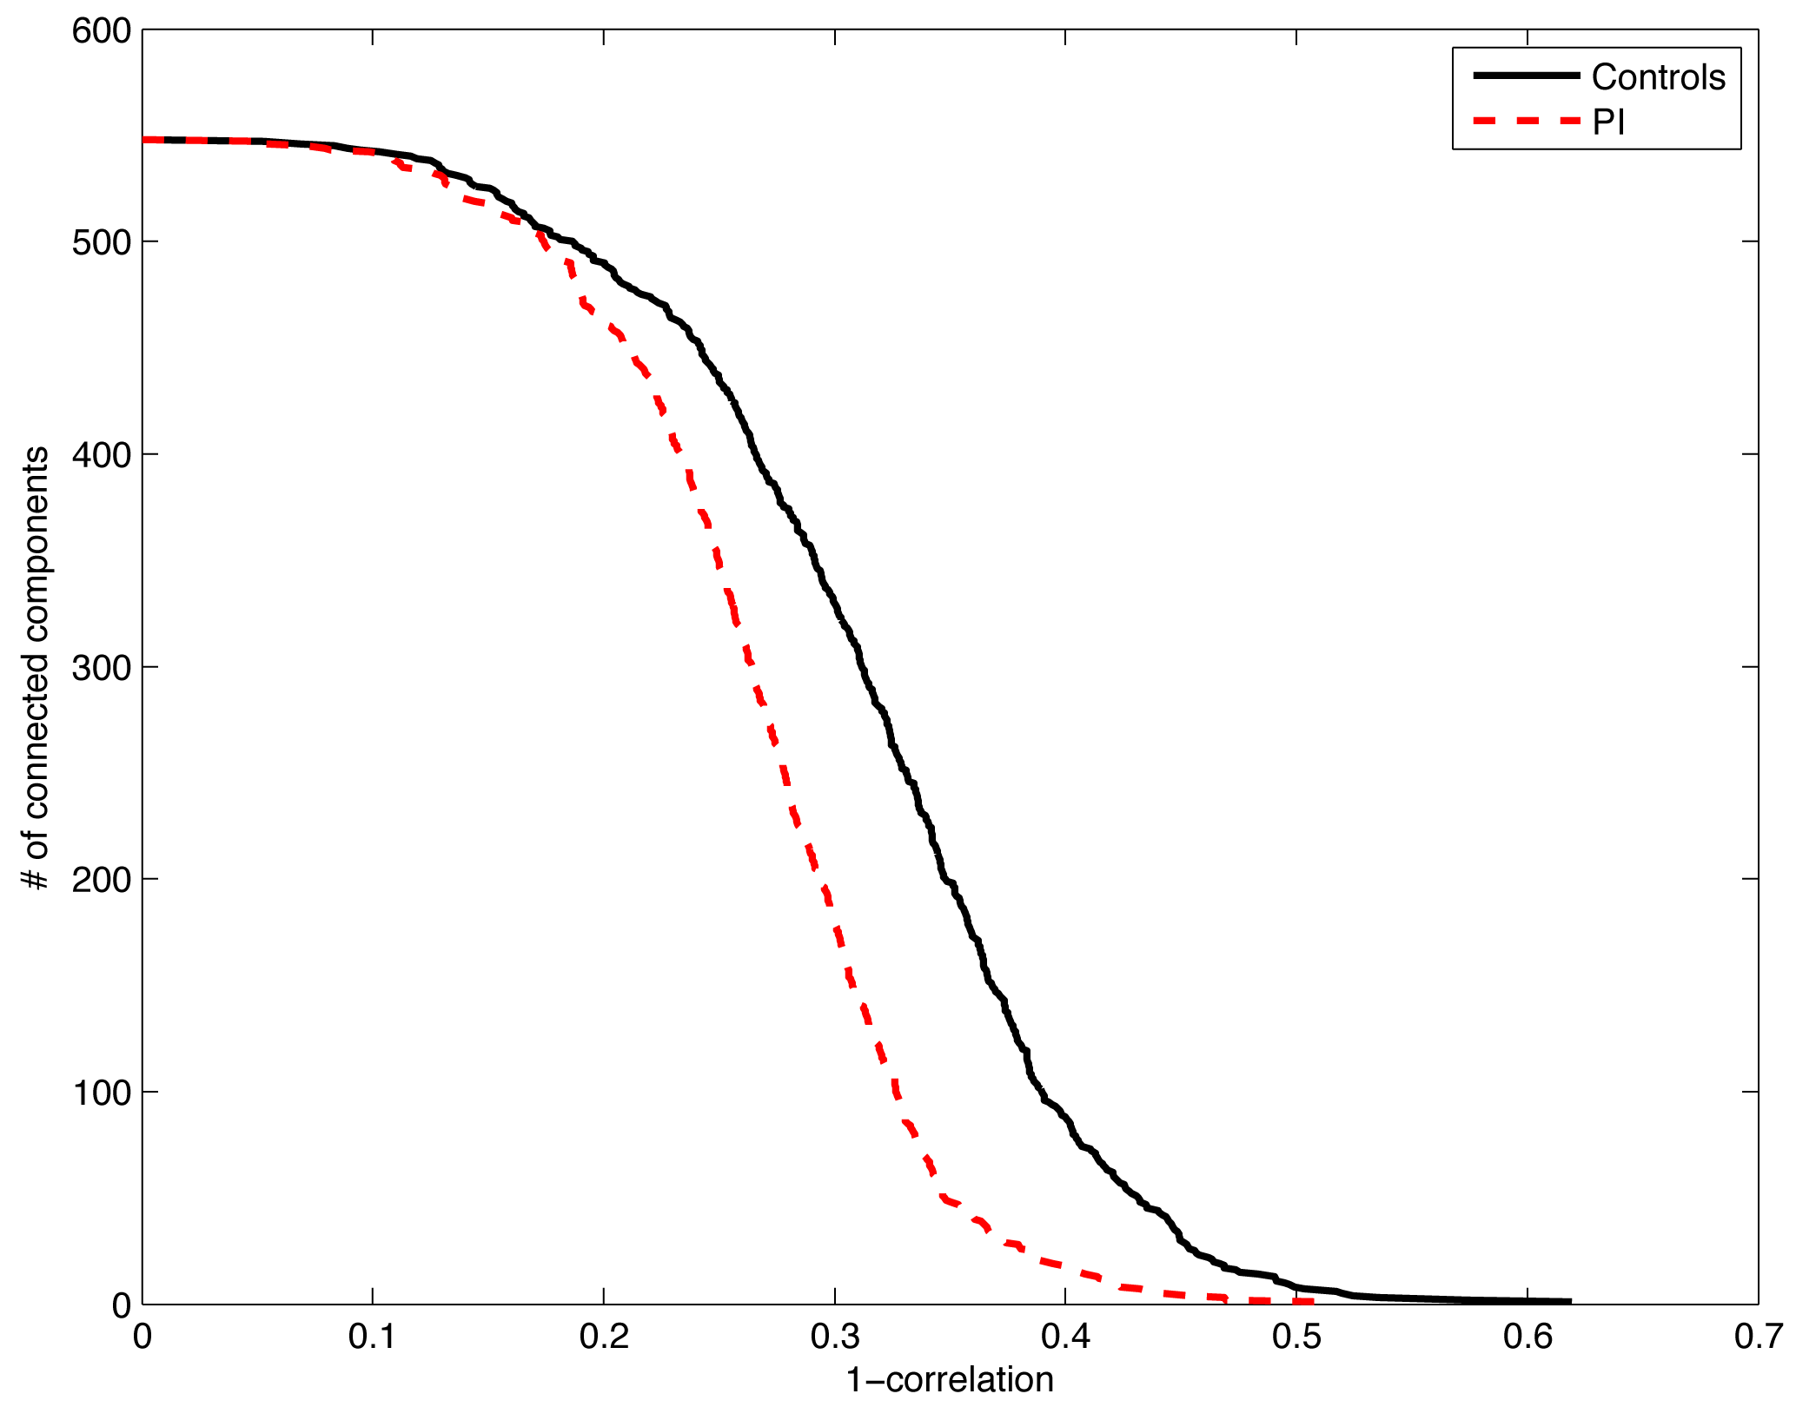
Barcodes on # of connected components

Slide 20
What next?
Trying to check the strength of DTI connections in those nodes showing the group difference

