Slide 1
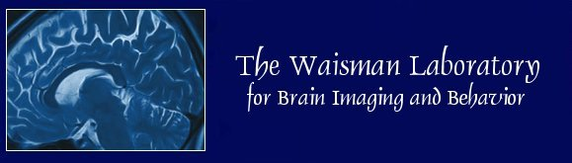

Heat kernel smoothing on manifolds and its application to longitudinal brain substructure modeling
Moo K. Chung
Department of Biostatistics and Medical Informatics
Waisman Laboratory for Brain Imaging and Behavior
University of Wisconsin-Madison
www.stat.wisc.edu/~mchung

Slide 2
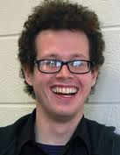
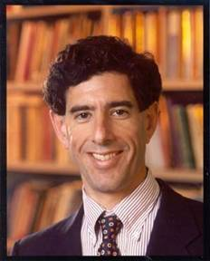
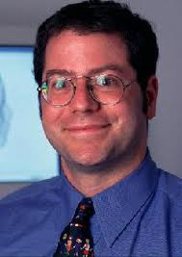
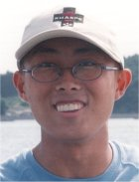
Acknowledgments
Jamie L. Hanson, Richard J. Davidson, Seth D. Pollak
University of Wisconsin-Madison
SeongHo Seo
Department of Brain and Cognitive Sciences
Seoul National University

Slide 3
Abstract
We present a novel kernel smoothing framework on an arbitrary manifold using the Laplace-Beltrami eigenfunctions. The Green’s function of an isotropic diffusion equation on a manifold is analytically represented first using the eigenfunctions of the Laplace-Beltraimi operator. The Green’s function is then used in constructing heat kernel smoothing analytically. Unlike many previous diffusion based smoothing approaches developed for manifolds data, diffusion is analytically solved avoiding various numerical instability and inaccuracy issues. Our method is compared to a widely used iterative kernel smoothing technique in brain imaging to show significant improvement in numerical accuracy. The proposed framework is illustrated with longitudinally collected hippocampus surfaces.

Slide 4
Effect of family income on hippocampus growth
86 teens from high income family (> $75000)
mean age = 12+/- 4 years
38 teens from low income family (< $35000)
mean age= 12 +/- 4 years old
Each subject has multiple scans (1-2 scans).

Slide 5
Image Processing

Slide 6
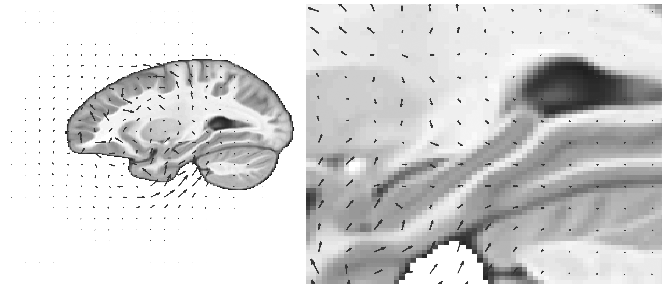
Image registration
Deformation from the template to a subject.

Slide 7
Longitudinal image processing
Scan 1
Scan 2
warp 1
warp2
Template
Deformation form the template to Scan2 is given by warp1 + warp2.

Slide 8
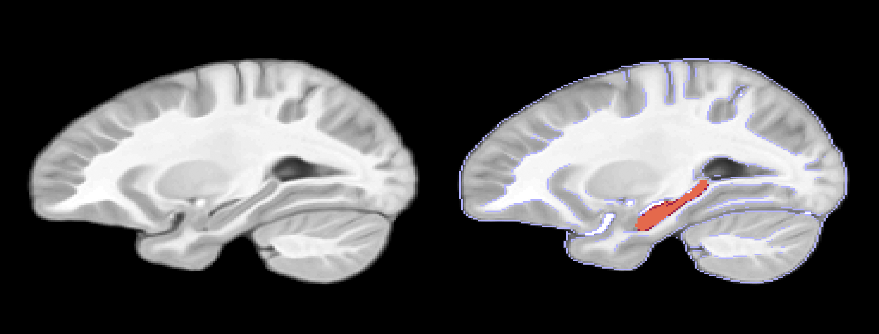
Manual hippocampus segmentation on MRI template

Slide 9
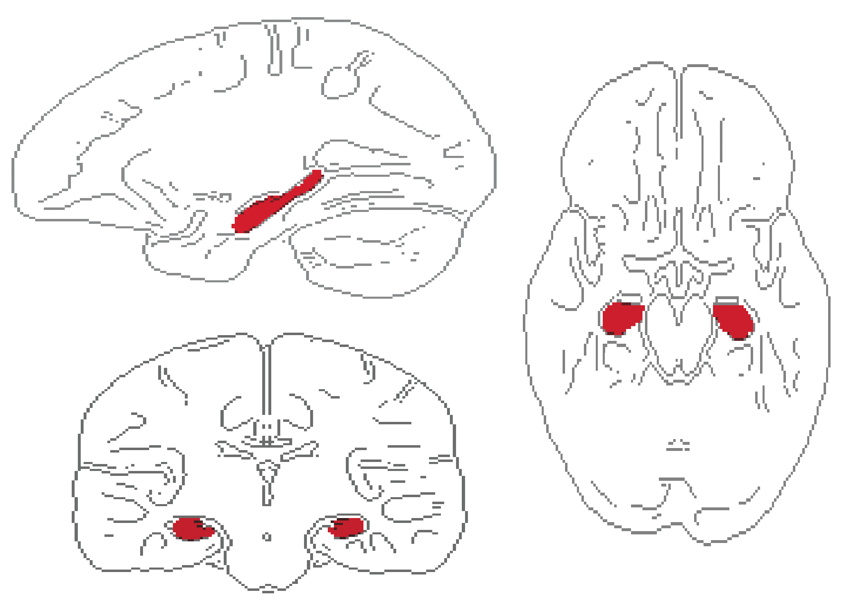
Subcortical structures: hippocampus

Slide 10
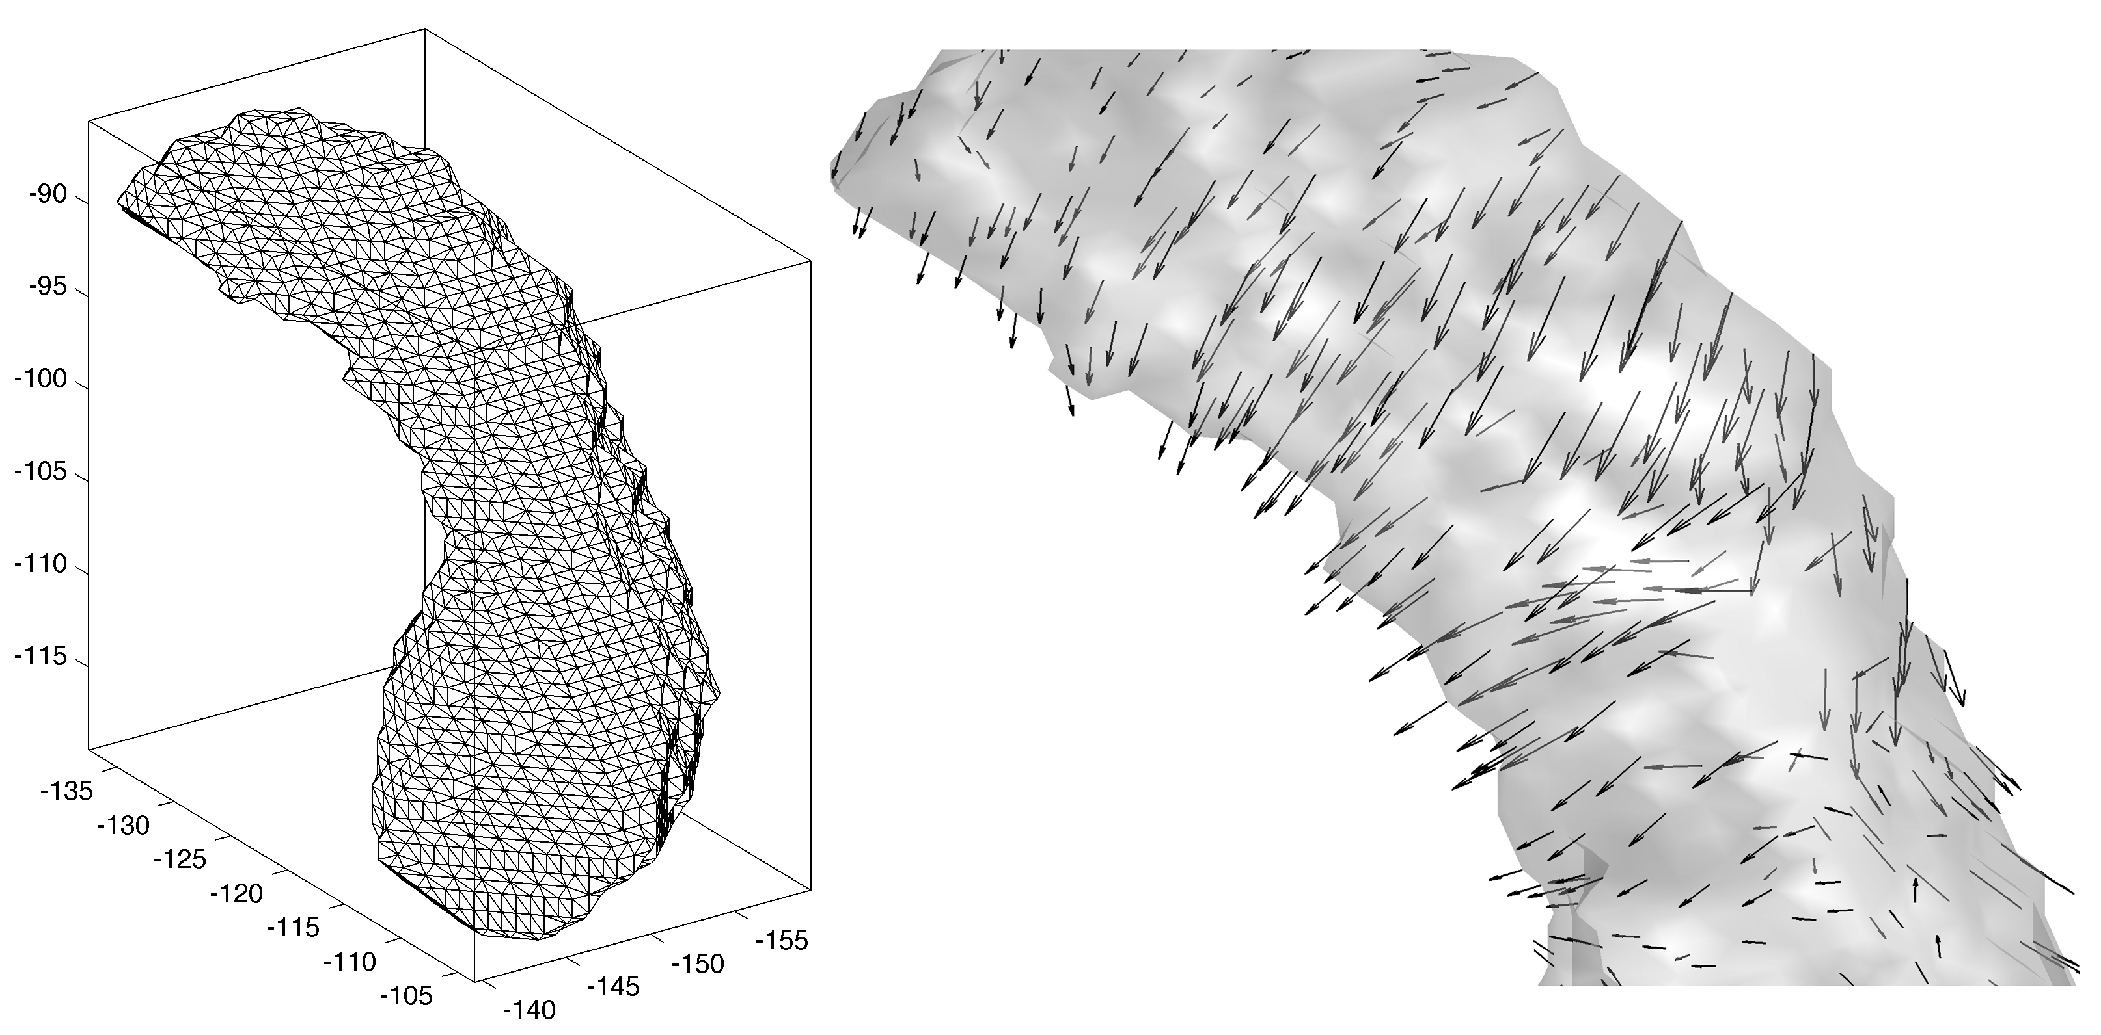
surface template & deformation on template
Deformation field
of warping the template
to a subject

Slide 11
Heat kernel smoothing on manifolds
Original idea given in Chung et al. 2005 (NeuroImage).
The most widely used cortical data smoothing technique in brain imaging.
Similar iterative smoothing methods are now implemented in FreeSurfer, AFNI, SurfStat.

Slide 12



Approximating heat kernel with Gaussian kernel
Parametrix expansion (Rosenberg, 1997):
for small bandwdith

Slide 13
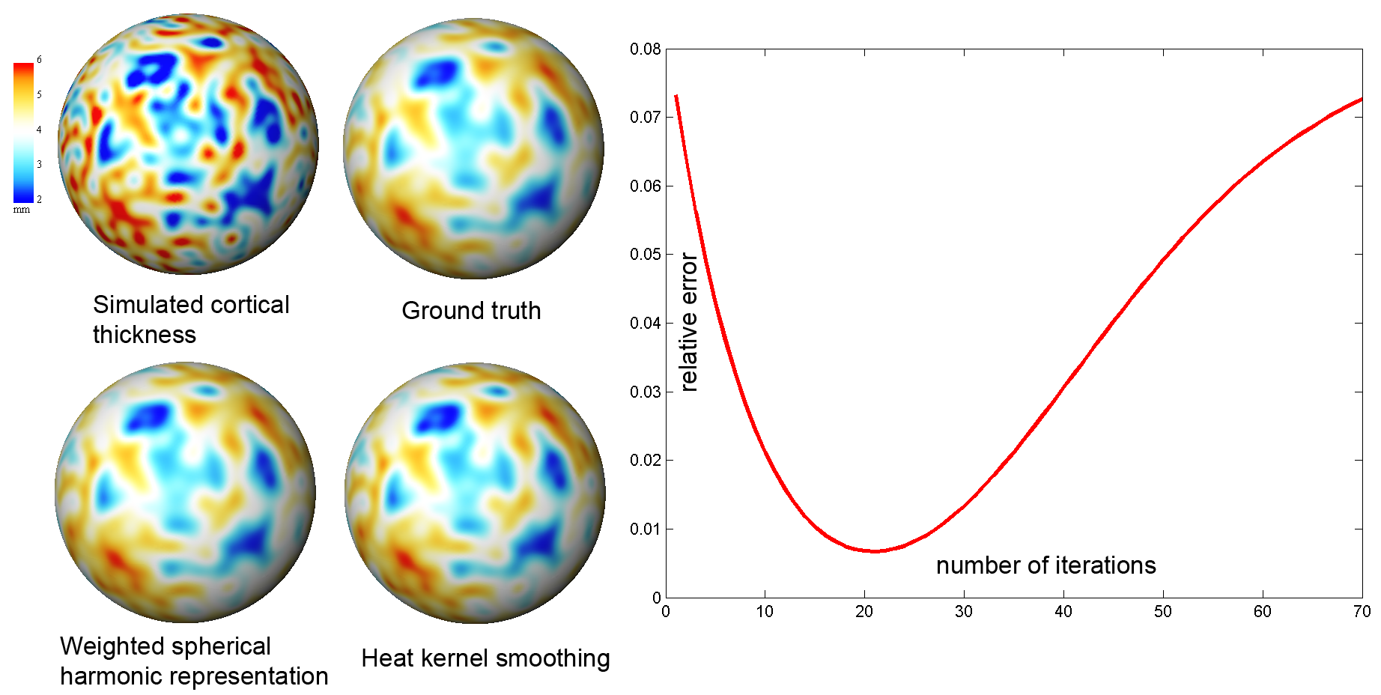
Validation against the ground truth
Chung et al., 2008. Statistica Sinica
Can we do better?

Slide 14
Laplace-Beltrami eigenfunctions

Slide 15
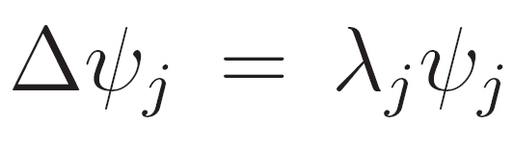
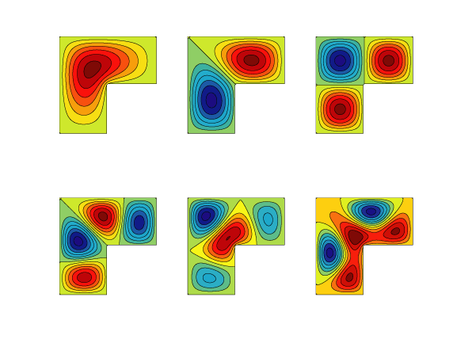
Eigenfunctions of Laplace-Beltrami operator
Helmholtz equation

Slide 16
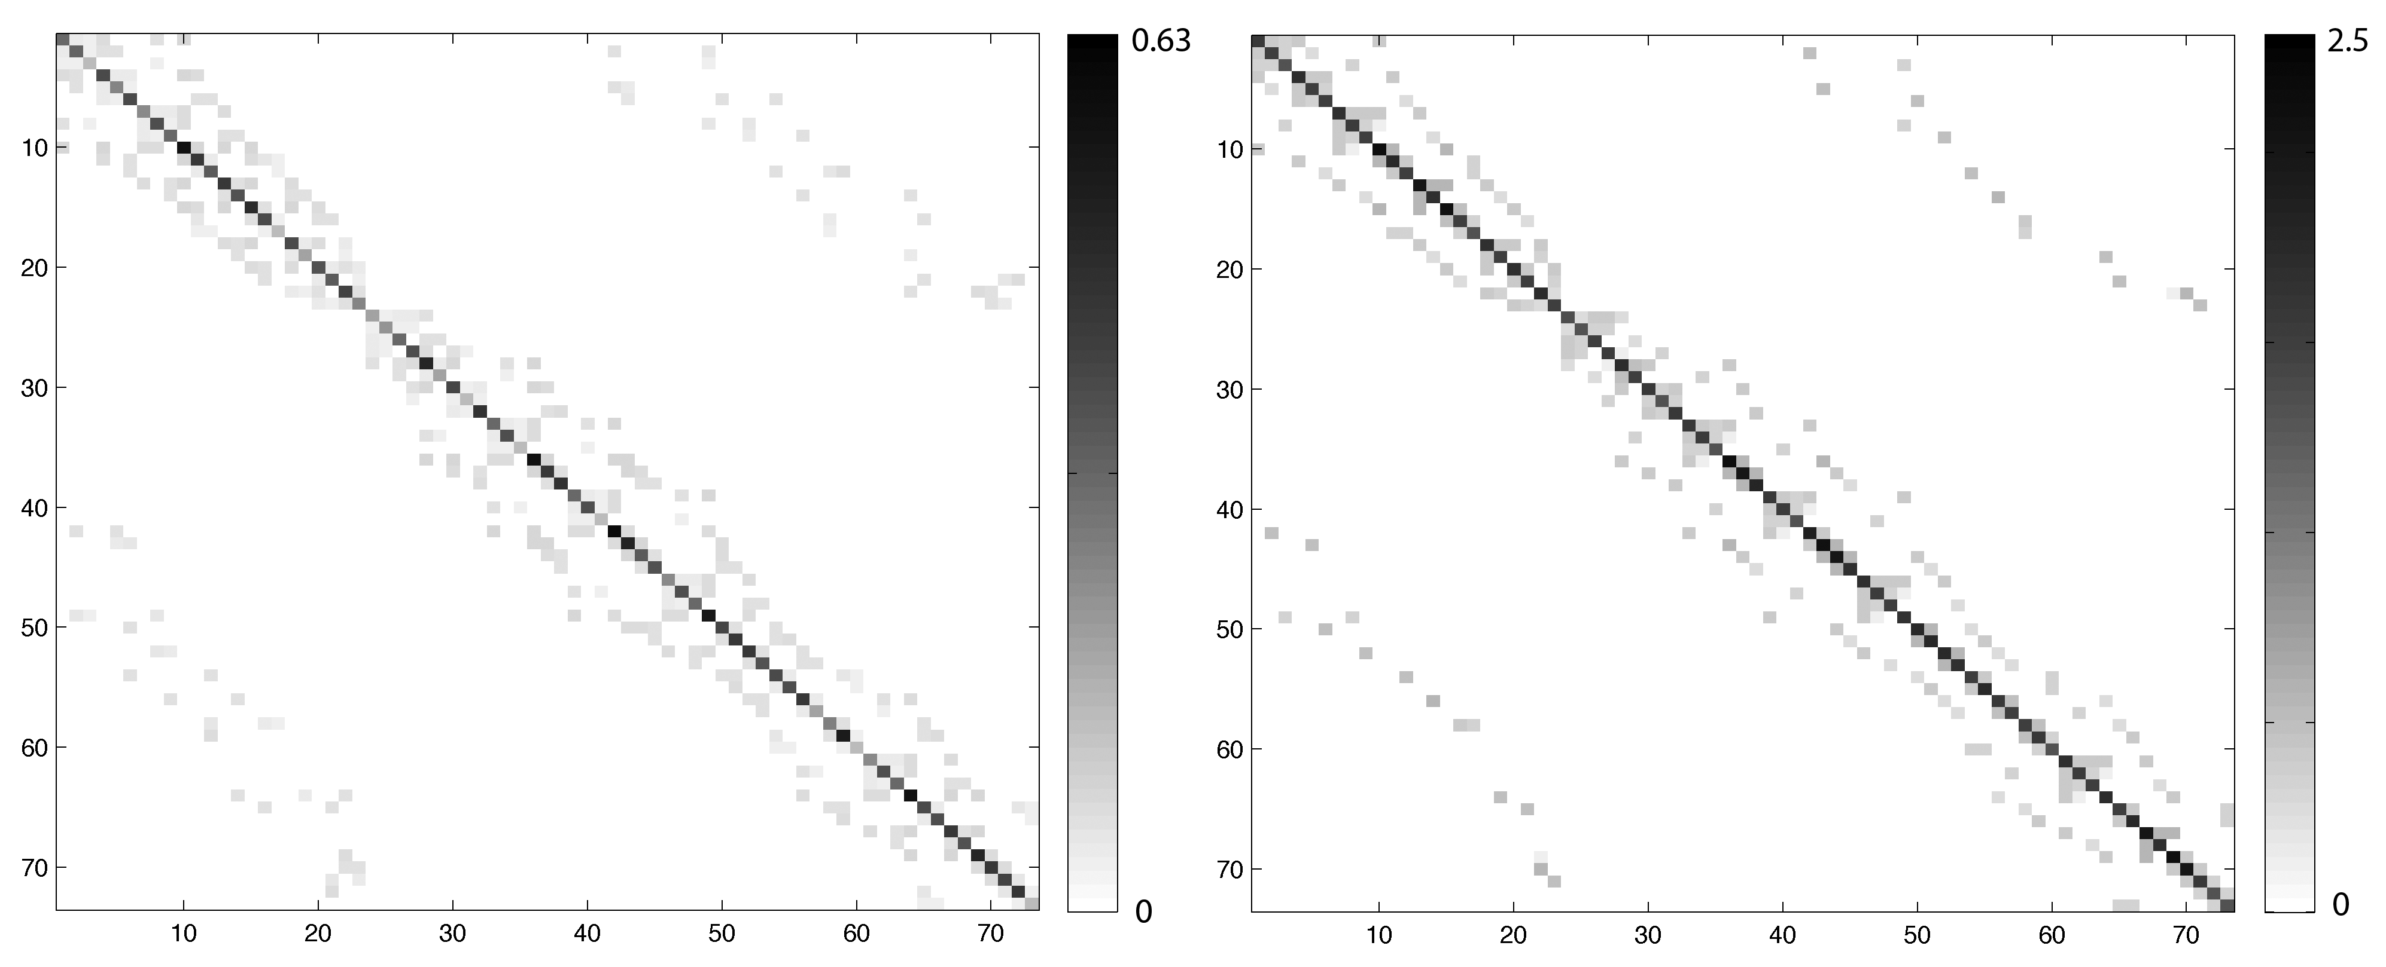


Generalized eigenvalue problem via FEM
Qiu et al. IEEE TMI 2006
Seo et al. MICCAI 2010

Slide 17
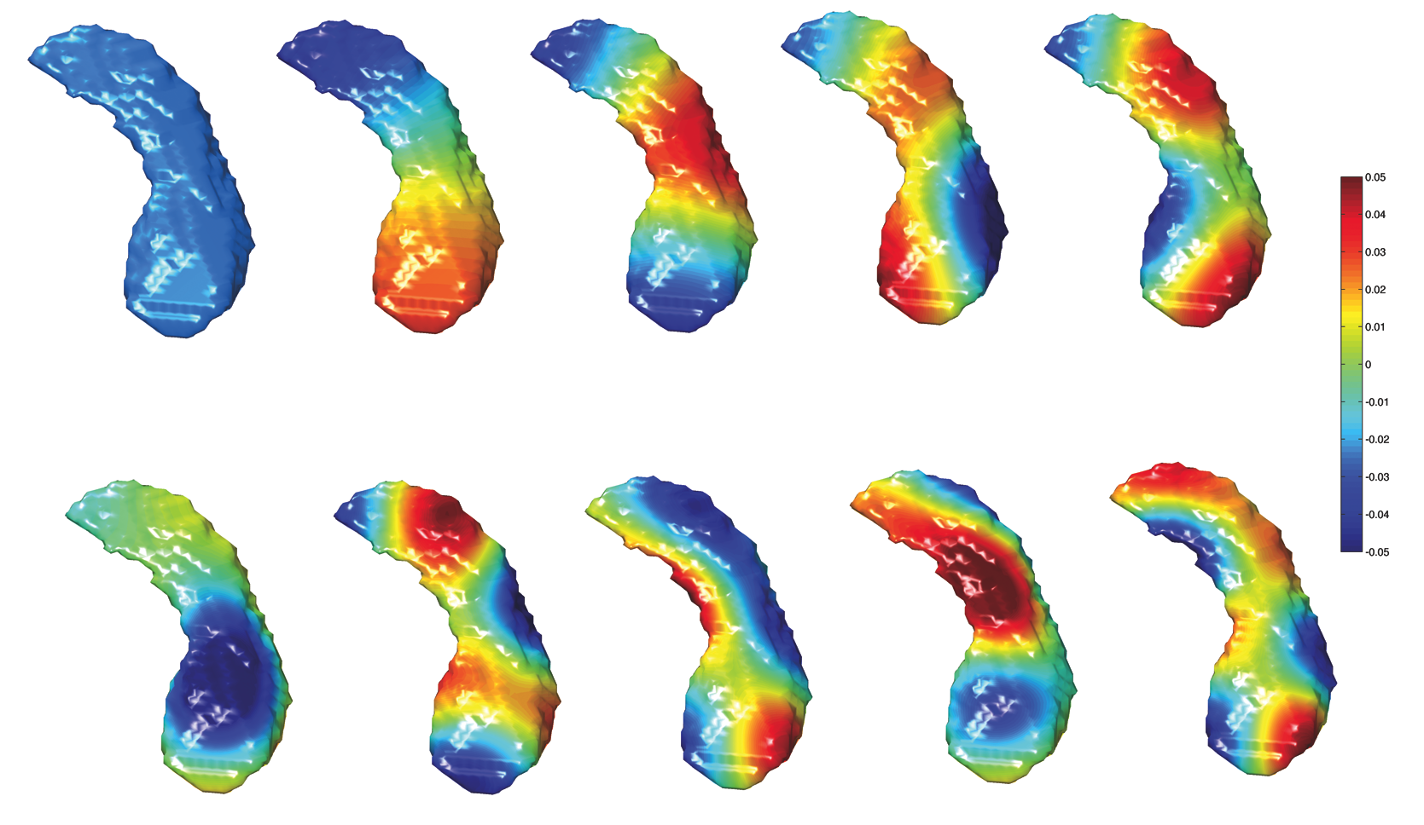
First 10 orthonormal basis on left hippocampus
MATLAB code available from my website.

Slide 18
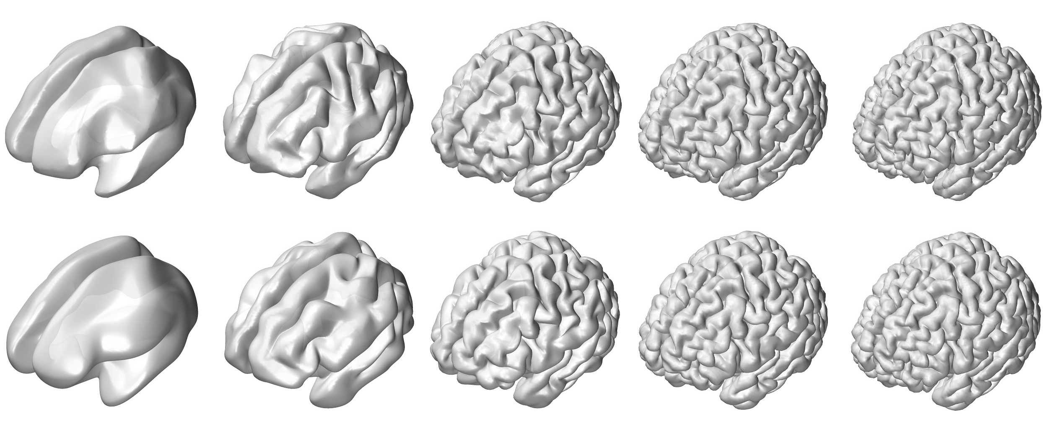
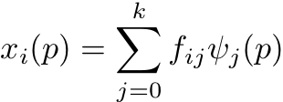
Laplace-Beltrami eigenfunction expansion
F
Laplace-Beltrami eigenfunction expansion
Spherical harmonic representation

Slide 19
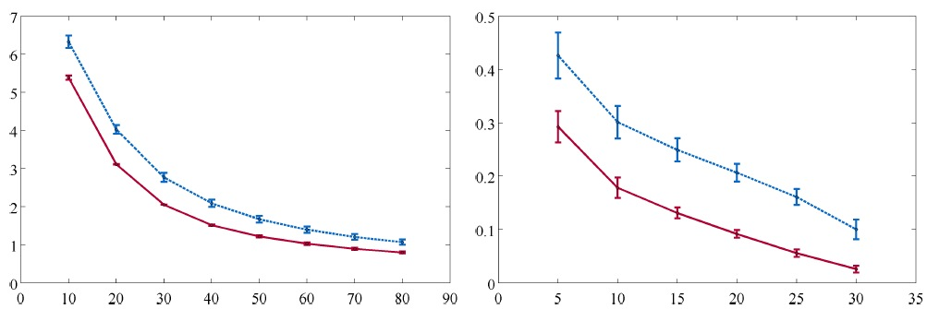
Reconstruction error
Red= LB-expansion
Blue= SPHARM
mm
Cortical surfaces
Amygdala surfaces
Seo at al. 2010. ISIB

Slide 20
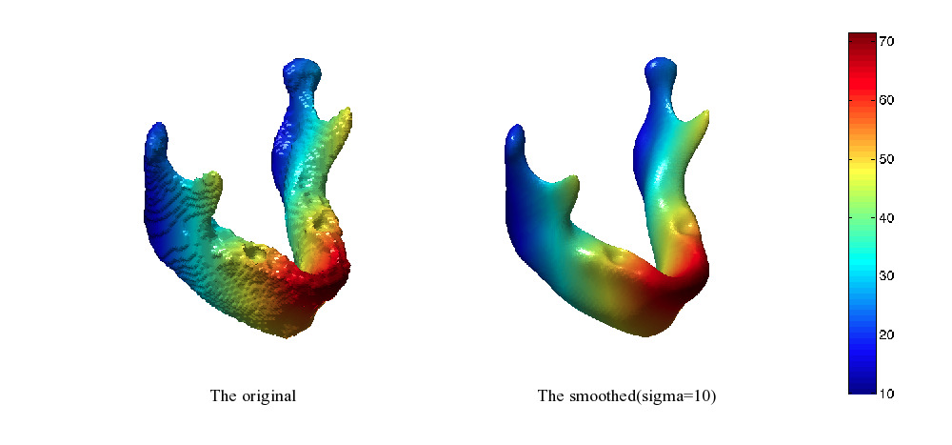
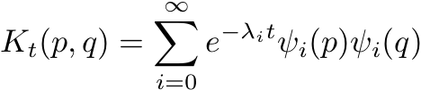

Heat kernel smoothing on manifold
Heat kernel:
x-coordinate on
mandible surface
smoothed with bandwidth 10
and 1269 eigenfunctions

Slide 21
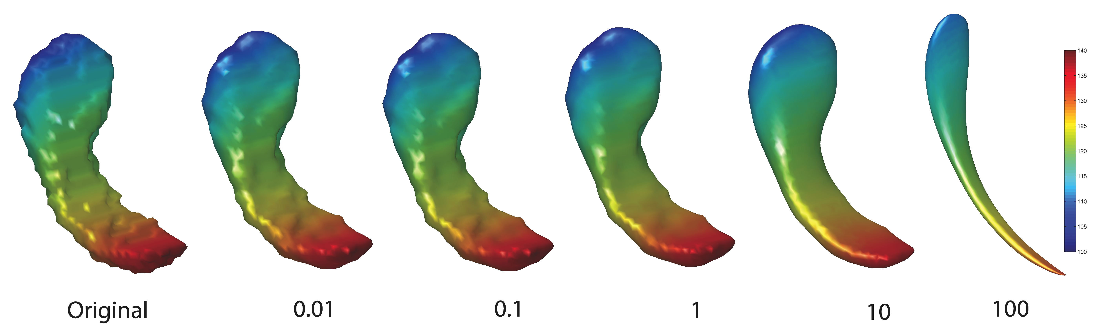
Heat kernel smoothing of hippocampus
Smoothing scale used in the study

Slide 22
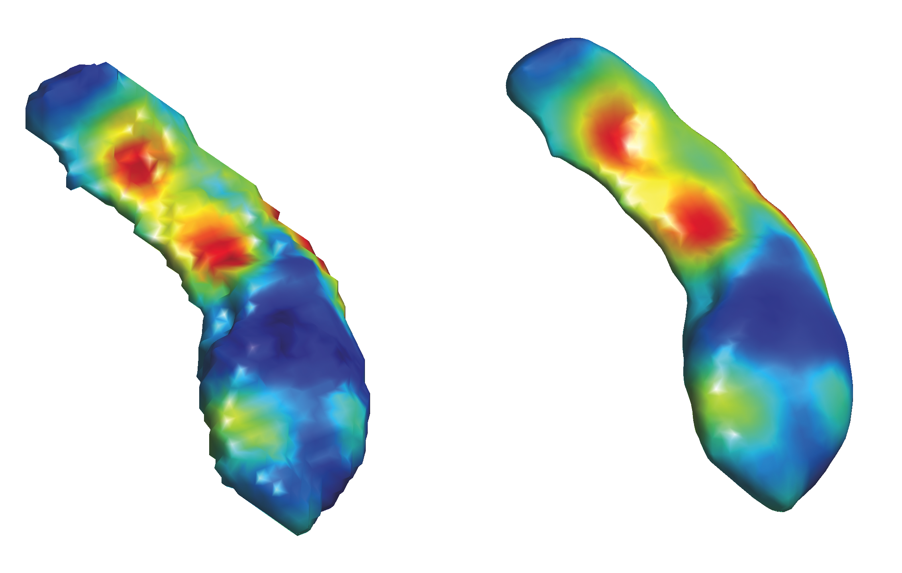
Heat kernel smoothing on hippocampus surface
Original deformation field
Heat kernel smoothing with bandwidth = 1

Slide 23

Mixed Effect Modeling
i-th subject, j-th scan (j=1,2)
Fixed effect model:
Mixed effect model:
Each subject has its own growth intercept and slope.

Slide 24
Results

Slide 25
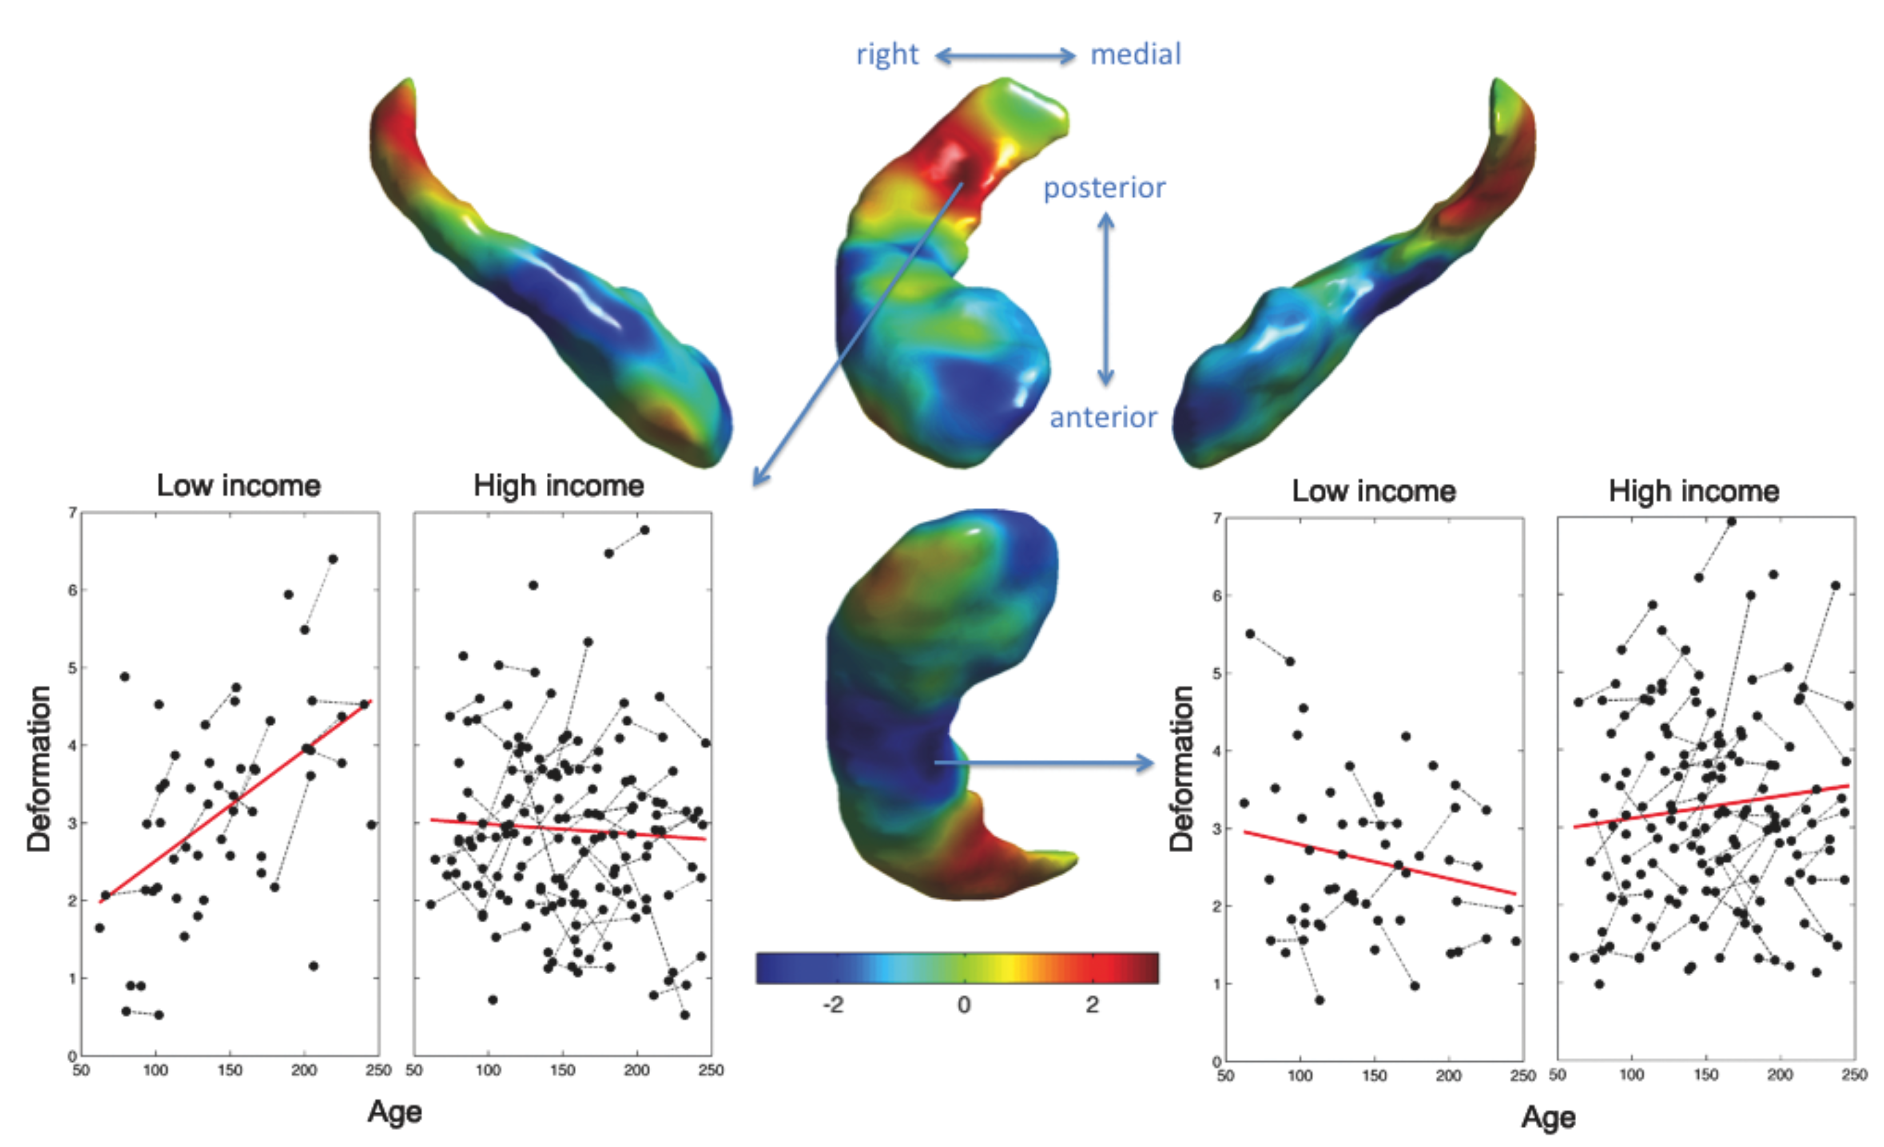
Effect of family income on hippocampus growth
Right hippocampus
pvalue = 0.025
pvalue = 0.05
Chung et al. HBM 2011

Slide 26
Conclusion
Low income level
→ Adverse environment
Stress
→ Abnormal hippocampus growth

Slide 27
Next Project

Slide 28
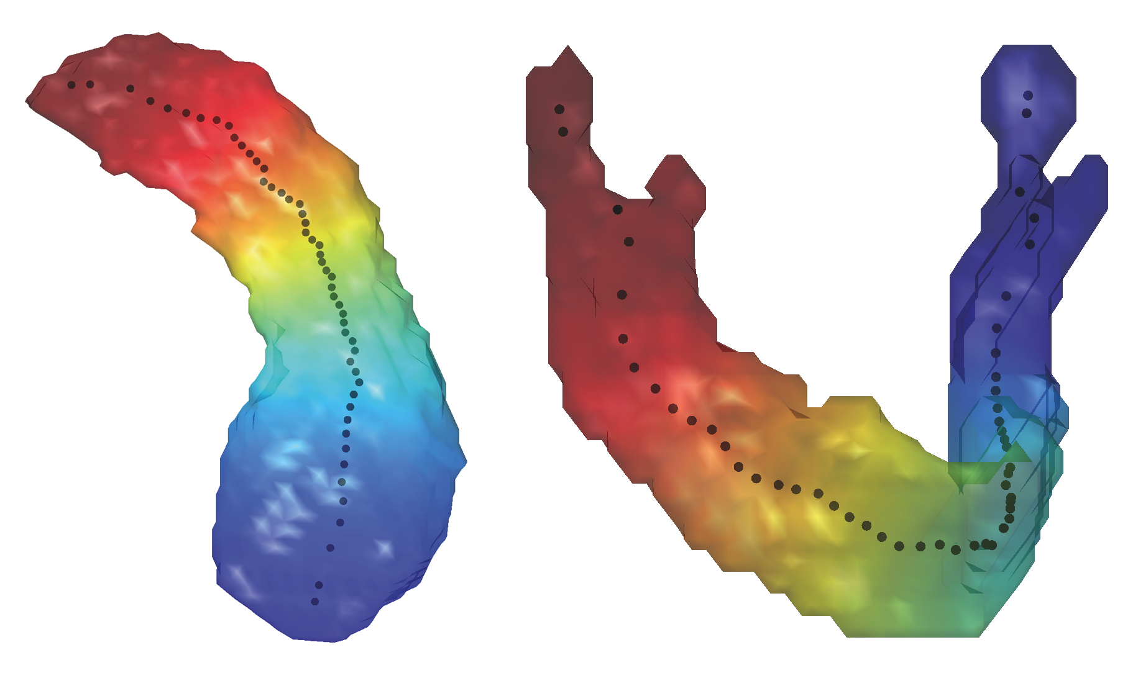
Second eigenfunction of elongated objects
Hot spot conjecture in differential geometry:
Min and max of the second eigenfunction always occur at the extreme end points or boundary

Slide 29

Rauch’s hot spot conjecture unsolved since 1974:
Mean signal over manifold
Error term
The heat kernel smoothing asymptotically behaves like the second eigenfunction.

Slide 30
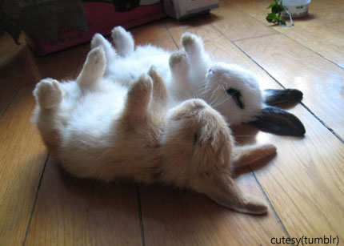
Thank you
MATLAB codes can be downloaded from
www.stat.wisc.edu/~mchung

