Slide 1
Christa M Wille, PT, DPT; Samuel A Hurley, PhD; Nagesh Adluru, PhD; Rebecca Alcock, Bryan C Heiderscheit, PT, PhD, Richard Kijowski MD
RSNA 2019
December 3rd, 2019
Chicago, IL
Quantitative Muscle Microstructural Changes detected with Diffusion Tensor Imaging following Hamstring Strain Injuries in Collegiate Athletes
Notes:
Background- in preparation for full imaging meeting/recap next week

Slide 2
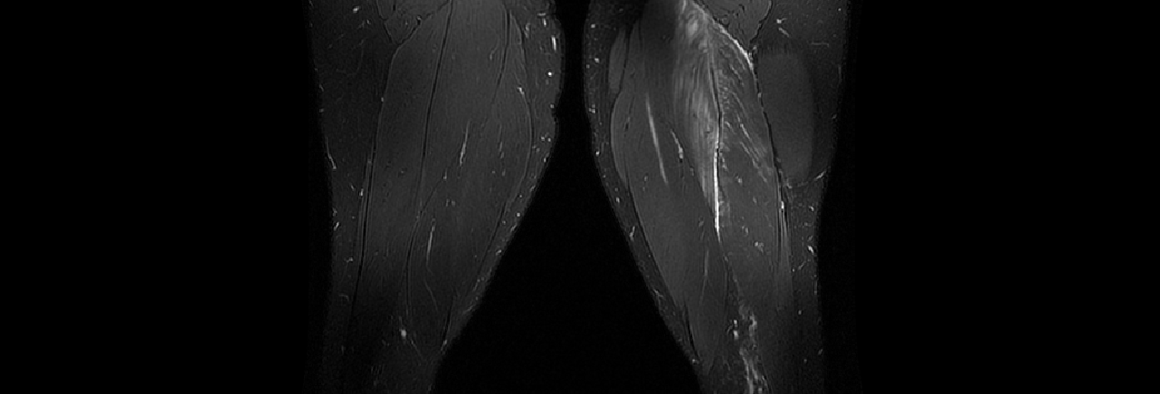
Background
MRI is a valuable tool for evaluating musculoskeletal injuries
  Diagnosis of injury
  Grading of injury severity
Limited evidence to support imaging to assist with prognosis and plan of care following hamstring injury
Potential for MRI as an scientific measuring instrument
Wagensteen et al. (2015) BR J Sports Med.
Greenkey et al (2017) J Sports Med
Notes:
I don’t have to tell any of you that MRI is considered a valueable tool for evaluating MSK injuries.
However, there is limited evidence to support the utility of… following HSI specifically
Maybe it’s time for a paradigm shift in MSK radiology and learn from our colleagues in neuroradiology who implement MRI in clinical practice as a scientific, quantitative measuring instrument as opposed to a subjective report indicating whether or not an injury is present.
MRI most common tool for evaluating soft tissue injuries
Evidence based reviews indicate physicians and radiologists cannot provide an accurate prognosis following an HSI with conventional MRI findings
Paradigm shift- MRI is no longer just a camera but a scientific measuring instrument
Current technological advances related to quantitative applications of MRI have demonstrated significant clinical utility
Diffusion tensor imaging (DTI)

Slide 3
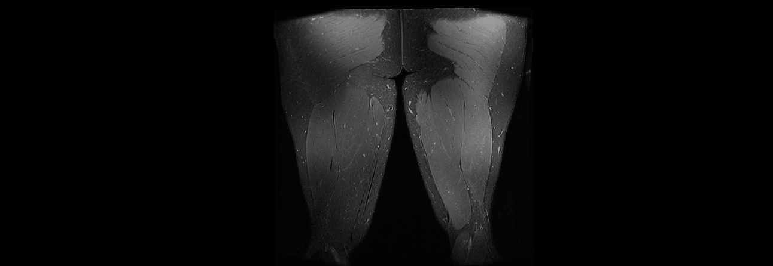

How Severe is the Injury?
Grade 0
Grade 1
Grade 2
Grade 0
Grade 1
Grade 3
Grade 0
Grade 1a
Grade 3b
Female, Track
Days to RTS: 29 days
Female, Soccer
Days to RTS: 12 days
Male, Football
Days to RTS: 21 days
Modified Peetrons
BAMIC
BAMIC + Subclassification
Grading of muscle injury shows limited association with injury prognosis
Notes:
The clinicians in the room are all too familiar with the questions, “How bad is it doc? When can I go back?” More often than not, our response is well it depends…
But there’s no clear consensus as to what the answer to that question depends on.
There are a few select muscle injury grading scales, but no agreement on which one to use. To help demonstrate each of these scales, you see here 3 athletes with different injury presentations on TOI MRI imaging fluid sensitive T2 images
Grade 0: negative MRI without any visible pathology
Grade 1: edema but no architectural distortion or tear
Grade 2: architectural disruption indicating partial muscle tear
Grade 3: total muscle or tendon rupture
Grade 0: Negative MRI findings
Grade 1: Small injuries (tears) to the muscle
Grade 2: Moderate injuries (tear) to the muscle
Grade 3: Extensive tears to the muscle
Grade 4: Complete tears to either the muscle or tendon
(myofascial, MT, intratendious AND 2nd subclassification that utilizes estimates of extent of edema to grade severity of injury)
Despite the good intentions and time spent on developing these tools, Little evidence on the reliability or validity of these measures. Likely due to the variability of these injuries as noted here with these 3 athletes.
Ekstrand J, Healy JC, Walden M, Lee JC, English B, Hagglund M. Hamstring muscle injuries in professional football: the correlation of MRI findings with return to play. Br J Sports Med. 2012;46(2):112-117.
Peetrons P. Ultrasound of muscles. Eur Radiol. 2002;12(1):35-43.
Pollock N, James SL, Lee JC, Chakraverty R. British athletics muscle injury classification: a new grading system. Br J Sports Med. 2014;48(18):1347-1351.

Slide 4
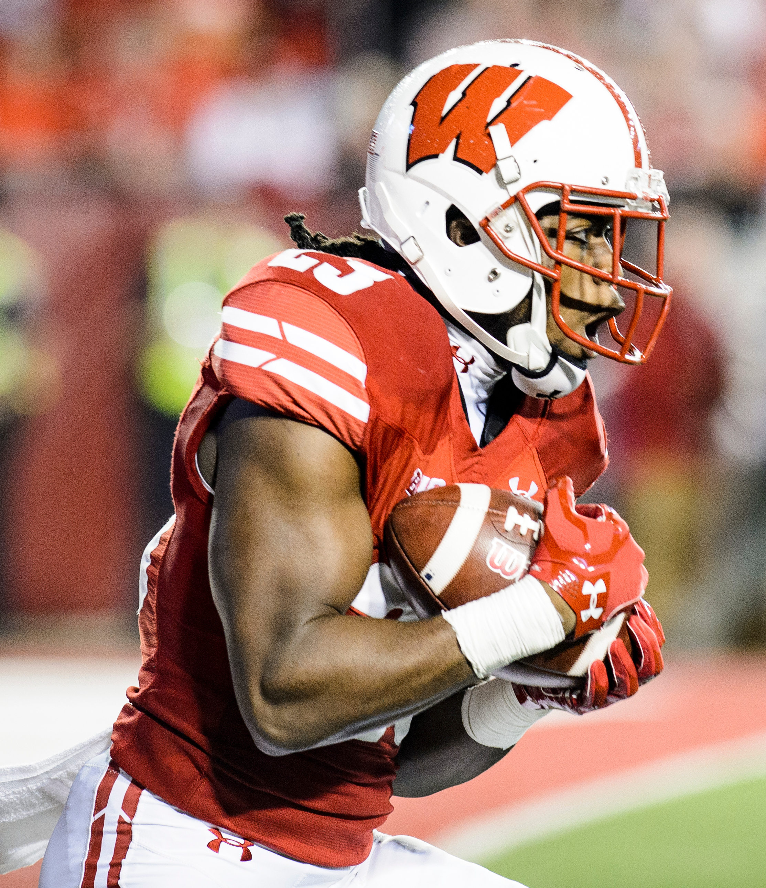
Methods
Subjects: Division 1 athletes who sustain a hamstring strain injury
  Injury evident on T2-weighted MRI, requiring time loss from sport
  Football, track, soccer
Timeline:
Time of Injury
Conventional Imaging
Rehabilitation
Individualized program led by athletic trainer using standardized guidelines
Return to Sport
Clinical assessment
Monitor
Quantitative Imaging
Pain, ROM, Strength
Eccentric strength
Conventional Imaging
Quantitative Imaging
Monitor and record reinjury with the assistance of teams’ athletic trainers
Clinical assessment
Pain
*Within 7 days of injury
Running Mechanics

Slide 5
Methods: MRI Sequences
Sequence | Voxel Size (mm) | Matrix Size | Repetition Time (ms) | Echo Time (ms)
Axial T1 | 0.43 x 0.43 x 9.00 | 1024 x 1024 x16 | 788 | 15.3
Coronal T1 | 0.47 x 0.47 x 9.00 | 1024 x 1024 x16 | 571 | 15.3
Ax T1 SPGR | 0.43 x 0.43 x 5.00 | 1024 x 1024 x16 | 6.16 | 2.20
Ax FRFSE T2 IDEAL ARC | 0.86 x 0.86 x 9.00 | 512 x 512 x 16 | 4,679 | 88.6
Cor FRFSE T2 IDEAL ARC | 0.86 x 0.86 x 3.00 | 512 x 512 x 16 | 7,408 | 86.8
Upper-thigh DWI 30dir AP/PA* | 3.00 x 3.00 x 3.00 | 160 x 160 x 16 | 5,756 | 50.90
Lower-thigh DWI 30dir AP/PA* | 3.00 x 3.00 x 3.00 | 160 x 160 x 16 | 5,756 | 50.90

Slide 6
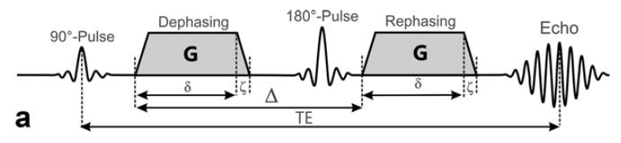
Methods: DWI Sequence
3.0T scanner, 32-channel torso coil
Stejskal-Tanner pulsed gradient spin echo sequence
  b-value of 500 sec/mm²
  30 directions
  Repeated with reverse
  phase-encoded directions
Post-processing
  TOPUP- distortion correction AP, PA
  Eddy- eddy and motion correction (affine to unweighted diffusion volumes)
Sequence | Voxel Size (mm) | Matrix Size | Repetition Time (ms) | Echo Time (ms)
Upper-thigh DWI 30dir AP/PA* | 3.00 x 3.00 x 3.00 | 160 x 160 x 16 | 5,756 | 50.90
Lower-thigh DWI 30dir AP/PA* | 3.00 x 3.00 x 3.00 | 160 x 160 x 16 | 5,756 | 50.90
Oudeman et al. (2008) J MRI
Notes:
To address this question, I have had help from our medical physics team to establish and implement a DWI sequence on our 3T scanners using a 32-channel torso coil.
Post processing steps include:
G the gradient strength, $δ$ the gradient duration, $ζ$ the rise time of the gradients, and $∆$ the delay between the leading edges of the two pulsed field gradients. Adapted from Oudeman et al.¹

Slide 7
Diffusion Tensor Imaging
Good repeatability with all ICC values <0.70
ICC = 0.73 – 0.95
ICC = 0.74 – 0.93
ICC = 0.73 – 0.94
ICC = 0.73 – 0.92
Notes:
microstructure of a healthy myofibril will encourage water to flow in a direction primarily along that of the fiber
Just say % difference
1-4% difference across limbs

Slide 8




Methods: Image Analysis
Manual segmentation
  Muscle ROI- T1 weighted sequences
  Edema ROI- T2 weighted sequences
Involved limb ROI
  Intersection of muscle and edema ROI
Uninvolved limb ROI
  Mirrored edema ROI manually registered to uninvolved limb
BFsh
BFsh
BFlh
SM
SM
BFlh
ST
ST
Masks were overlaid on DTI maps to identify average parameters
Outcome measures: Fractional Anisotropy (FA), Mean diffusivity (MD), radial diffusivity (RD), eigenvalues (λ1, λ2, λ3)
Notes:
To address this gap, I hope to use select dimensional characteristics of the ROI identified with manual segmentation to demonstrate a significant association with days to RTS. Our study team has developed reliable and repeatable methods to manually segment the areas of edema to create a volumetric representation of the ROI. Dimensional characteristics from these volumes including CC, ML, AP lengths, as well as max CSA and volume of edema will be correlated with days to RTS. We do expect to see trends with increased size of injury and increased days to RTS.
Show mirrored regions and methods more, superimposed over DTI images
Hidden slides with RTS and edema size
More about subjects

Slide 9
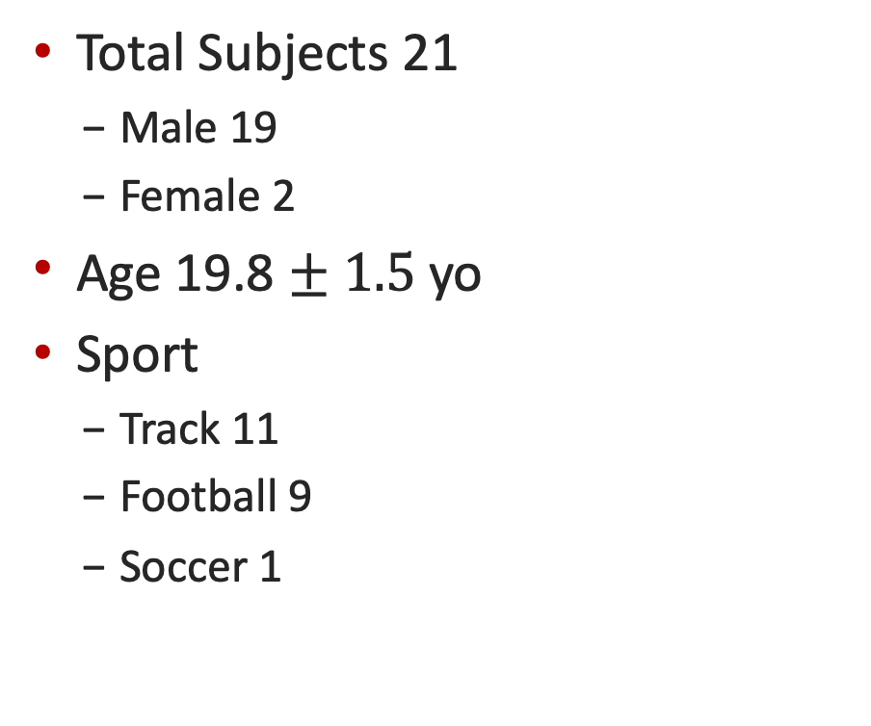
Results: Subject Demographics
Total Subjects 21
  Male 19
  Female 2
Age 19.8 $± 1.5$ yo
Sport
  Track 11
  Football 9
  Soccer 1
Injured Limb
  Dominant 13
  Non-dominant 8
Previous History of HSI
  Ipsilateral Limb 4
  Contralateral Limb 5
  Bilateral 5
  None 7
Notes:
9 Left
12 Right
Subsequent Injury
Ipsilateral (reinjury) - 5
Contralateral - 2
None on record - 14

Slide 10

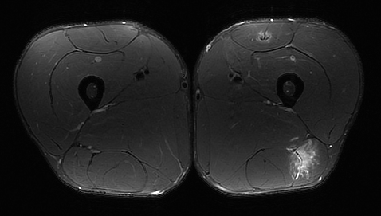
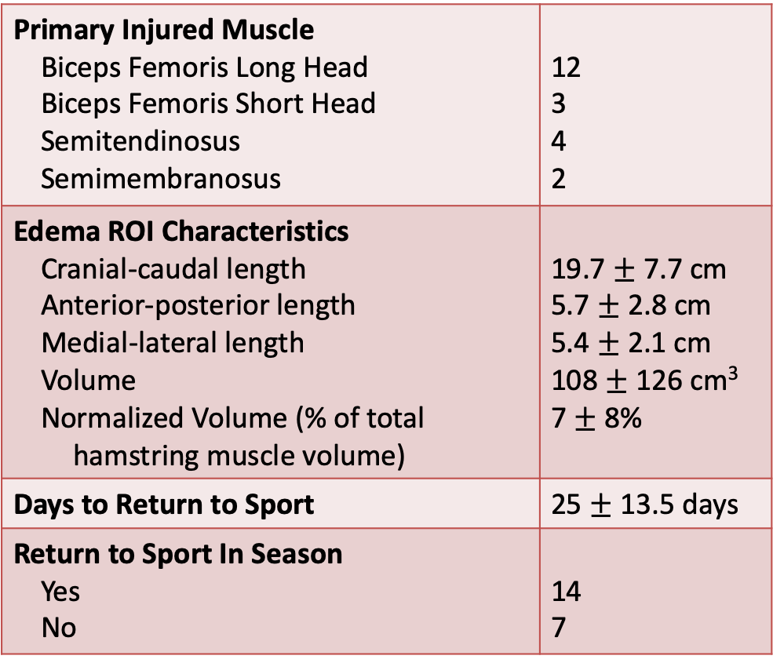
Results: Injury Descriptions
Primary Injured Muscle Biceps Femoris Long Head Biceps Femoris Short Head Semitendinosus Semimembranosus | 12 3 4 2
Edema ROI Characteristics Cranial-caudal length Anterior-posterior length Medial-lateral length Volume Normalized Volume (% of total hamstring muscle volume) | 19.7 $±$ 7.7 cm 5.7 $±$ 2.8 cm 5.4 $±$2.1 cm 108 $±$ 126 cm³ 7 $±$ 8%
Days to Return to Sport | 25 $±$ 13.5 days
Return to Sport In Season Yes No | 14 7
247 mm
43 mm
38 mm
Notes:
9 Left
12 Right
Subsequent Injury
Ipsilateral (reinjury) - 5
Contralateral - 2
None on record - 14

Slide 11
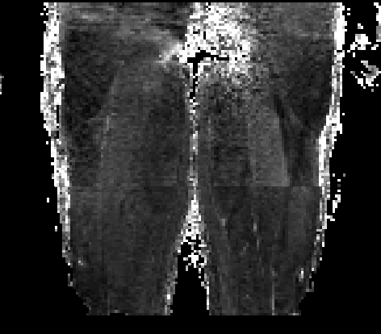
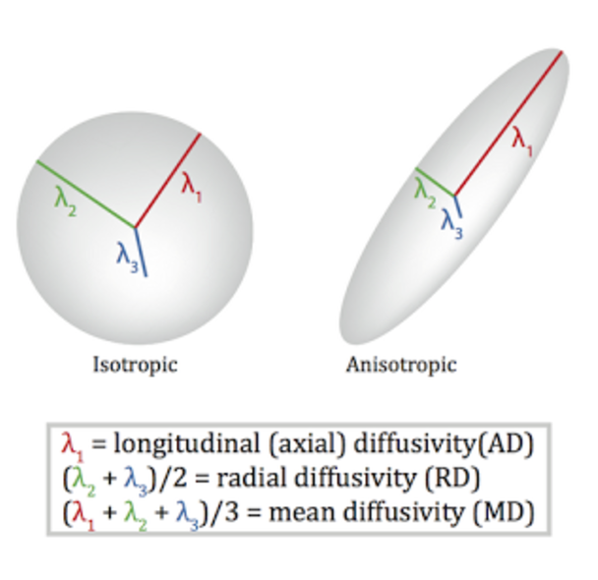
Results: Fractional Anisotropy
FA = 0
FA = 1
Isotropic
Anisotropic
Notes:
Often the diffusion tensor is described using scalar metrics for statistical analyeses. One common scalar metric used to describe diffusion is FA. FA describes the degree of difference among the eigenvalues to reflects diffusion anisotropy as shown in the equation.
FA is a dimensionless scalar index ranging from 0 to 1 that is used to quantify diffusion anisotropy, with 0 representing a completely isotropic medium and 1 representing a cylindrically symmetric anisotropic medium
When imaging damaged muscle fibers, we would expect to see a lower FA value in the involved limb. As evidenced by the initial analysis completed here. In red you see the involved limb demonstrated a lower FA value that the uninvolved.

Slide 12
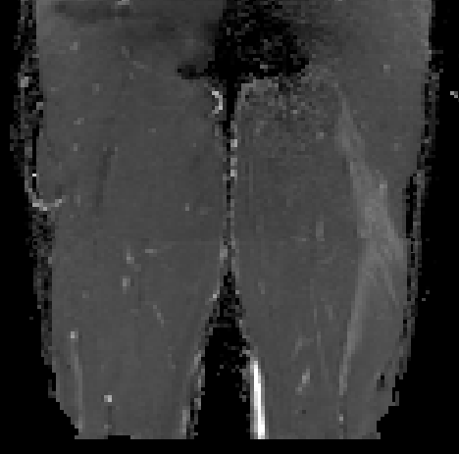
Results: Mean Diffusivity
Notes:
Mean Diffusivity is calculated exactly as it sounds, by taking the average of the diffusion occurring in each direction. The difference between FA and the other diffusivity measures is that with injury, we now expect to see increased diffusivity of the involved region.

Slide 13
Results: Eigenvalue $λ1$
Notes:
Lambda1 represents the largest, also known as the principal eigenvalue. This variable is used to quantify the diffusion occurring along the fiber axis. Associated with each eigenvalue is an eigenvector to describe the direction of diffusion. The image you see here on the left is a color coded map representing information from the eigenvectors. In this map, blue represents CC, red ML, green AP. As expected, over the region of injury we see a deviation from the expected blue color to represent the CC direction of muscle fibers. Instead we see rainbow of colors.

Slide 14
Results: Eigenvalues $λ2 \& λ3$
Notes:
L 2 and L3 represent the intermediate and smallest eigenvalues, respectively and they correspond to water diffusion occurring transverse to the fiber axis. Similar trends exist in these values with decreased diffusivity on the involved limb

Slide 15
Results: Radial Diffusivity
Notes:
Radial diffusivity is the average of diffusion occurring along the transverse axis and no surprise, a consisted increase in diffusion in the ROI is apparent here as well.

Slide 16
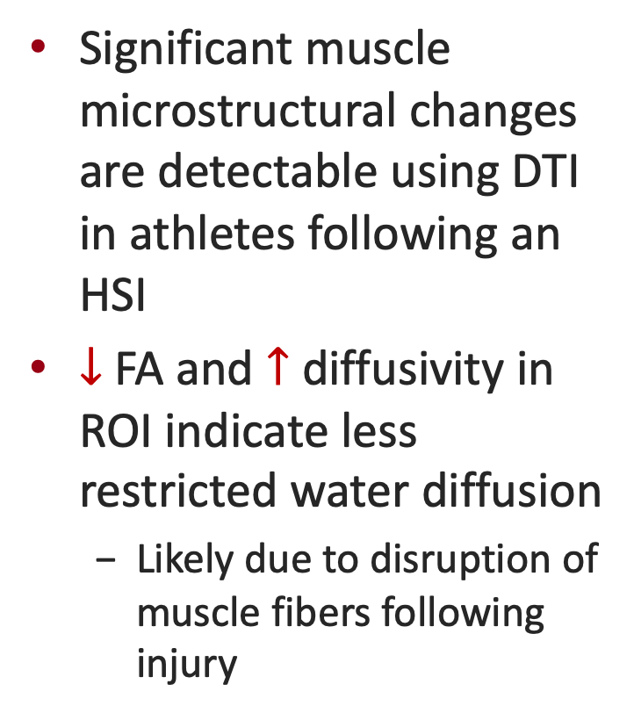
Results: Summary
Significant muscle microstructural changes are detectable using DTI in athletes following an HSI
$↓$ FA and $↑$ diffusivity in ROI indicate less restricted water diffusion
  Likely due to disruption of muscle fibers following injury

Slide 17

Tractography
Deterministic streamline tractography
Euler integration with a step size of 0.1 mm
  Stopping criteria:
    45$°$curvature threshold
    < 0.20 FA threshold
Involved
Uninvolved
Involved ROI
Mirrored ROI
Notes:
Only show upper portion
shim would be bad if did one whole sequence
TR somewhat of a limiting factor
Send Nagesh another subject with injury only in upper
MSK specific tractography criteria- FA threshold??
FA <0.20
Derministic crteria but future work would be probabilistic criteria
Then will try to derive quantiative muscle fiber length

Slide 18
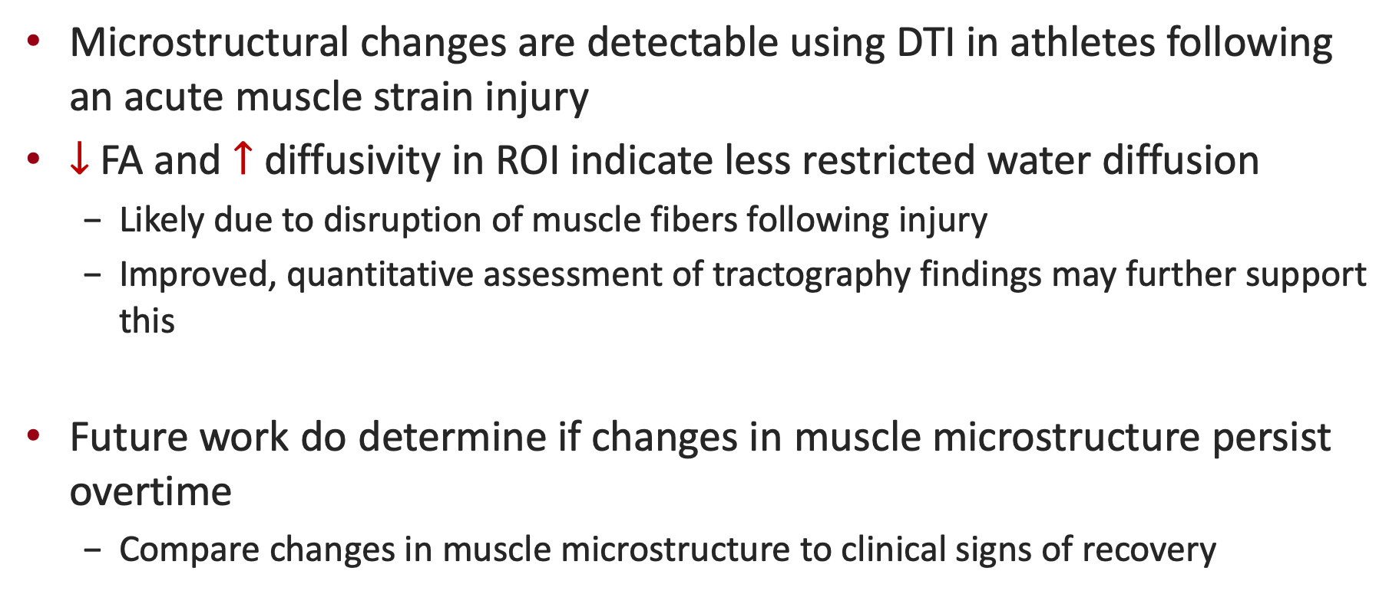
Conclusions
Microstructural changes are detectable using DTI in athletes following an acute muscle strain injury
$↓$ FA and $↑$ diffusivity in ROI indicate less restricted water diffusion
  Likely due to disruption of muscle fibers following injury
  Improved, quantitative assessment of tractography findings may further support this
Future work do determine if changes in muscle microstructure persist overtime
  Compare changes in muscle microstructure to clinical signs of recovery

Slide 19
Acknowledgements
Principle Investigators
  Richard Kijowski, MD
  Bryan Heiderscheit, PT, PhD
Contributors
  Samuel Hurley, PhD
  Nagesh Adluru, PhD
  Mikel Stiffler-Joachim
  Kenneth Lee, MD
Students
  Rebecca Alcock
  Elizabeth Schmida

Slide 20
References

